Slide 1
Argumentation in Human-Computer* Interaction Sarit Kraus Dept of Computer Science Bar-Ilan University Israel
* Joint work with Ariel Rosenfeld

Slide 2
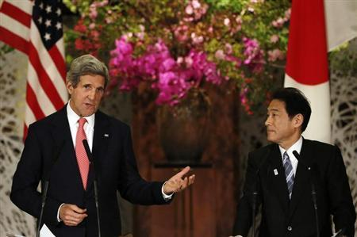
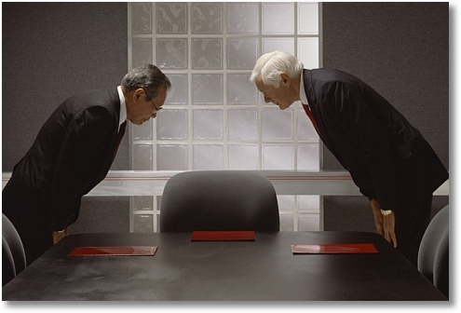
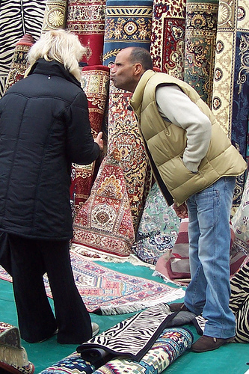
Motivation: Training People

Slide 3
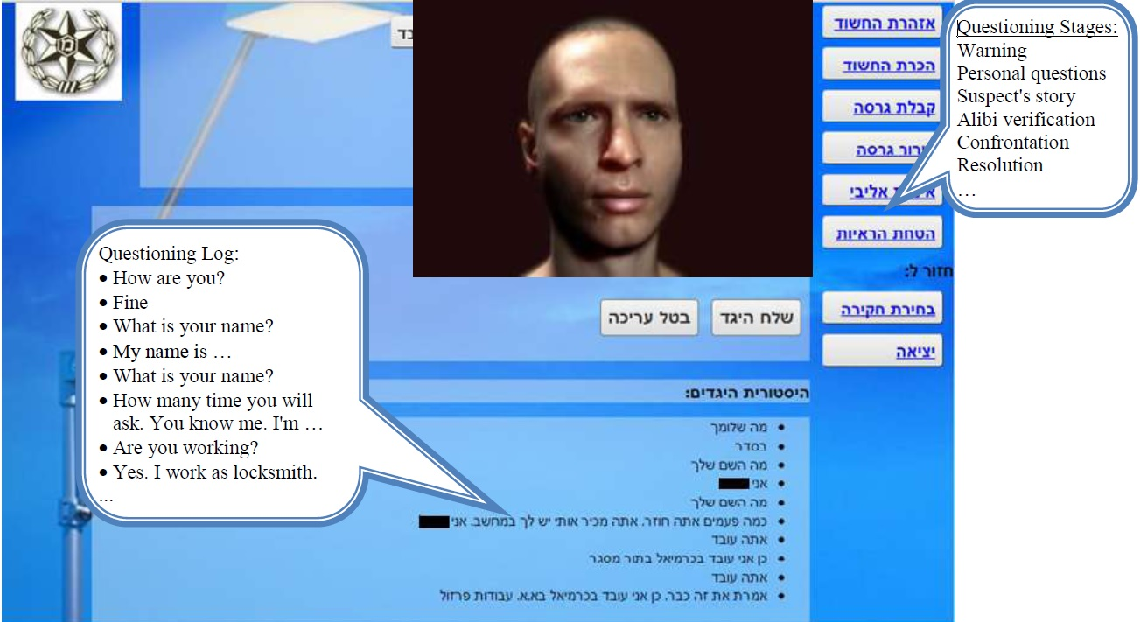
Motivation: Training People Virtual Suspect

Slide 4
Supporting People in Argumentation
4

Slide 5
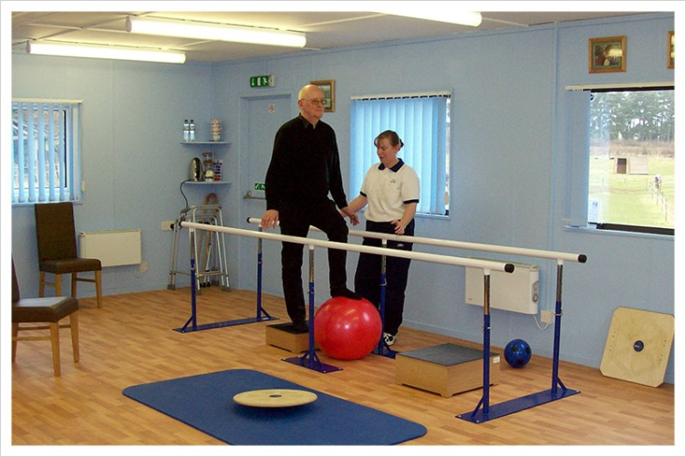
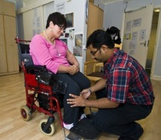
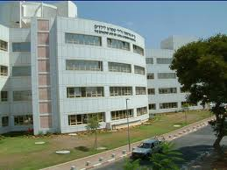
Persuasion: Medical Applications: Rehabilitation & Care
Reinforcement for rehabilitation in an inpatient rehabilitation unit
Personalized automated speech therapist
5
Sheba Hospital

Slide 6
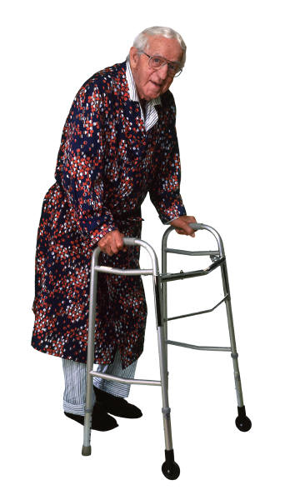
Automated care-taker
I arrange for you to go to the physiotherapist in the afternoon
I will be too tired in the afternoon!!!
How can I convince him? What argument should I give?

Slide 7
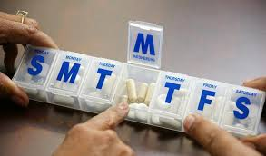
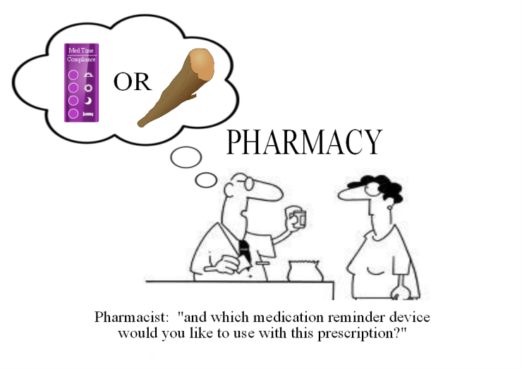
Persuasion: Medical Applications: Medicine Compliance
P: The drug makes me tired
A: If you don’t take it your
probability of having a heart
attack will increase.
P: My mother took this drug and died
A few month after she started.
7

Slide 8
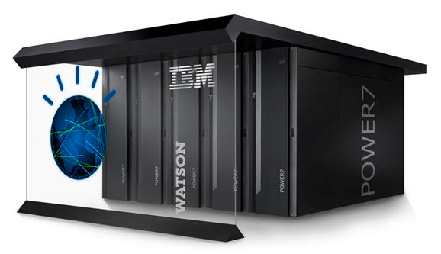
IBM: ”The Debater” (May 1st 2014)
An extension of Watson that given a topic, scans and extract pro and con arguments on it.
Main contribution: summarizing terabytes of data and finding pros and cons.

Slide 9
Modeling People’s Behavior in Argumentation

Slide 10
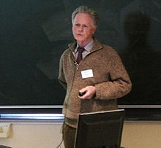
Argumentation Theory?
Extensions?
Validity values?
Justification value?
People do not reason logically.
People differ in their argumentation choices.
There is temporal nature of argumentation.
Dempster
Lehmann
Cayrol
Dung

Slide 11
Argumentation Theory? Data Collection of 6 fictional Cases
64 participants from Amazon Turk;
age average: 38.5
21 females; 17 males
3 with Phd

Slide 12
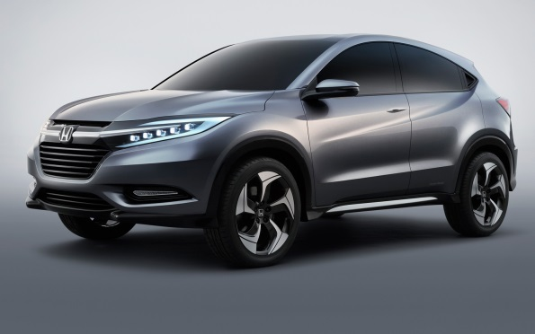
Argumentation Theory?
SUV
-0.23
Safe
8%
Too expensive
35%
High taxes
Taking a loan
Taking a loan
-0.33
33%
High interest
24%
Arvapally et al, 2012
Notes:
We can take a loan
Loans from the bank has a high interest so it is not a good idea. 0 of the leaves; Take a loan - -0.33

Slide 13
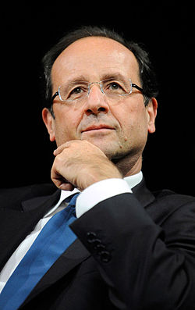
Argumentation Theory?
During a discussion between reporters (R1,R2) about the publication of an information piece concerning the person X, the following arguments were presented:
R1: this is an important information, we must publish it.
R2: this information concerns the person X, X is a private person and we can not publish an information about a private person without his agreement, and X does not agree with the publication.
R1: ?
X is a minister, so X is a public person, not a private person.
X has resigned, so X is no a minister any more.
X resignation was refused by the prime minister.
This piece is exclusive to us, if we publish it we can get a lot of appreciation by our readers.
Cayrol et. al 2008

Slide 14
Argumentation Theory?
publish
Exclusive
16%
Important
Private person
0
He is a minister
64%
-0.25
-0.33
He resigned
5%
0
Rejected
15%

Slide 15
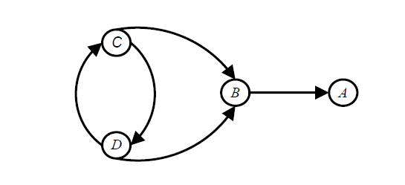
Behavioral Experiments for Assessing Reinstatement in Abstract Argumentation*
A
B
C
Conclusion: preferred argumentation semantics, “better than” grounded argumentation semantics.
Rahwan, Iyad, et al. Cognitive Science (2010)

Slide 16
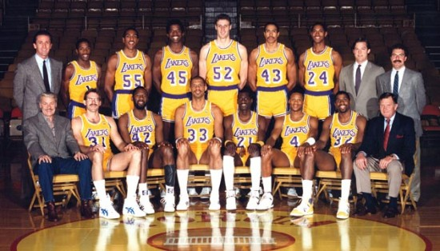
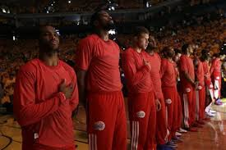
Dempster's Combination Rule?
Argumentation Theory?
Who will win?
Expert 1: 80% A , 20% B. = _{demp} 72.7% A ,27.3% B.
Expert 2: 40% A , 60% B.
Results:
62% completely agree with Expert 1, ignoring Expert 2.
15% asses exactly 50% to each team.
Only 23% asses the result somewhere between 70%-80%.

Slide 17
Argumentation Theory? Transcription of Real Discussions
SwitchBoard – Penn TreeBank Project (1995) conversation database:
CAPITAL PUNISHMENT (33)
TRIAL BY JURY (21)
Notes:
15 topics

Slide 18
Argumentation Theory? Transcriptions of Real Discussions
% of args in at least one extension | % of args in each extension | # of ext | Semantic
 | 26% | 1 | Grounded
 | 26% | 1 | Ideal
 | 26% | 1 | Eager
38% | 30%,28%,28% | 3 | Stable
38% | 30%,28%,28% | 3 | Preferred
Capital Punishment

Slide 19
Agent Supports Deliberation
Past deliberations accumulative data
Should there be more than
one winner to IFAAMAS thesis
award?
Current deliberation
Update
Capital punishment?
Agent
Offer arguments
Trial by jury?
= Obtains information
Notes:
Semantic independent

Slide 20
Formal Model
Argument (a)
Short text
Features (m)
General Argumentation Framework (GAF)
A (Arguments)
R (Attack relation)
S (Support relation)
∑ (undisputed information)
O (set of all available options)
Deliberation (D)
Takes place under some GAF
Updates the GAF in an incremental fashion

Slide 21
GAF
D
publish
publish
1: R1
2: R2
Exclusive
Important
Private person
Important
Private person
He is a minister
He resigned
rejected

Slide 22
Prediction of Argument Choice
Features:
Justification
Relevance
Psychological features.
Deliberation-based features (from the history of the current deliberation)

Slide 23
Justification Features
Cayrol’s calculation.
Theoretically justified propagating mechanism for evaluating “strength”.
Support Portion.
#direct_supporters / ( #directed_supporters + #direct_attackers)
Reduced Support Portion
#supporters / (#supporters + #attackers)
Qualitative Heuristics.
Pair-wise comparison of available options.

Slide 24
Cayrol’s Calculations
publish
Exclusive
Important
Private person
0
He is a minister
-0.25
He resigned
-0.33
rejected
0
Notes:
Private person --

Slide 25
Relevance features of a
Shortest path’s length from a to latest argument.
Shortest path’s length from a to the closest argument to a that was given.
Shortest path’s length from a to possible action.
Minimum of the all/some of the above features.
publish
Exclusive
Important
Private person
He is a minister
He resigned
rejected
Notes:
Annotation:
a – a possible argument.
al – the last given argument.
ac – the closest argument to a which was previously given
alpha – the course of action discussed.

Slide 26
Psychological features
Confirmation bias.
(B is confirming C)
Myside bias.
(A attacks D’s attacker)
Proneness to some option.
Notes:
What are the exact values of the feature in the example? Whether the B confirmed the last said argument?
A has myside bias since attach the attacker of [red last argument]

Slide 27
Deliberation-Based Features
Estimates the preferences of the user
Average in the latest chosen arguments
relevance
justification h
Approximation of his proneness
number of times in confirmation
Number of times for and against.
Approximation of the opposing side proneness.

Slide 28
One Time Argumentation Prediction Experiment of 6 fictional scenarios
publish
The subject is asked to choose between 4 options.
64 participants from Amazon Turk
age average: 38.5
21 females; 17 males
3 with Phd
78 computer science B.Sc. Students
Ave. age = 24.8
Male: 49; Females: 29
Exclusive
Important
Private person
He is a minister
He resigned
rejected

Slide 29
Predicting Subjects Choices using ML
Given 5 choices of a player, calculate the average of each feature, and predict the 6th one.
We used SVM (with SMOTE due to imbalances minority cases)
Notes:
This was done for all 6 scenarios
What are these averages?

Slide 30
Predictions the Argument
Given 5 choices of a player, calculate the average of each feature, and predict the 6th one.
Notes:
72% accuracy if past decisions are available.
Random offers 25% accuracy.
Majority choice provided 42%.
The performance improves as more answers are available.

Slide 31
Prediction if was Chosen
On “Yes” instances we have 42%-52% accuracy.
On “No” instances we have 79%-82% accuracy.
We had to use SMOTE to balance the data.

Slide 32
Features
“Relevance” most significant.
Cayrol’s calc. most significant among justification
Confirmation bias increase by 13.7%.
Myside bias was found to increased by 8.6%.

Slide 33
Culture based?
CS-77% > AT 72%
Computer Science – same exactly features as AT
Can learn from one and predict to the other.
BIU -> AT : 69% accuracy
AT -> BIU: 76% accuracy

Slide 34
Transcription of Real Discussions
Capital punishment:
33 examples
GAF of 33 nodes
Trial by jury
31 examples
GAF of 26 nodes
All arguments appeared in 4 examples

Slide 35
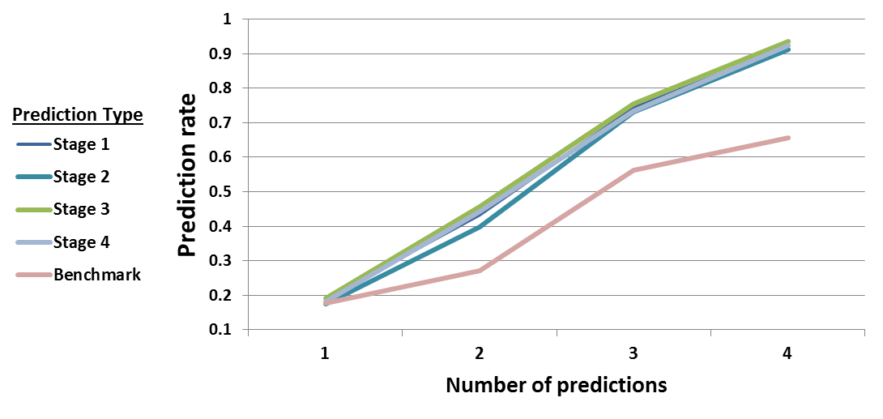
Capital Punishment

Slide 36
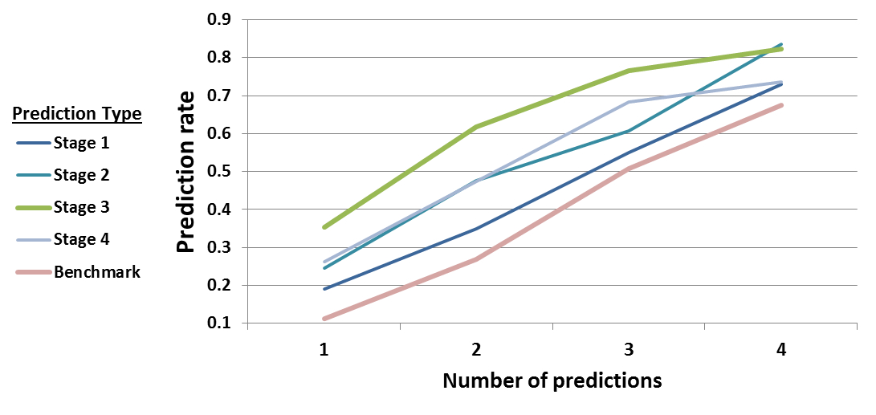
Trial by Jury
Notes:
Stage 1: first argument
Stage 3 one, two, three
Stage 4 there is a nois.

Slide 37
Predicting Subjects Choices using ML
Same attributes found influential in all settings.
DTL outperformed SVM.
Useful to use the beginning of the delibiration.
Two arguments in a row of the same person:
The second argument is usually in distance 1 from the first argument.
Most of the times it has a confirmation factor.
Accuracy 90% .
Notes:
If we ignore the first I argumntus, both in the training data and the test, the preformence declines.
Its an amendment to the prediction policy – we should learn from all the data we have, yet use predictions only from stage ~3 to get good results.
When a deliberant uses more than one argument in a row, the second argument is usually in distance 1 from the first argument and most of the times it has a confirmation factor (supports the first argument). In such case, prediction is much easier, and the results support it (90% success).

Slide 38
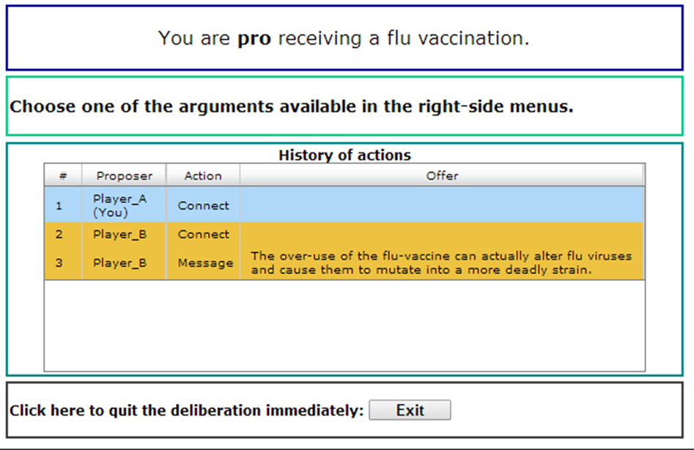
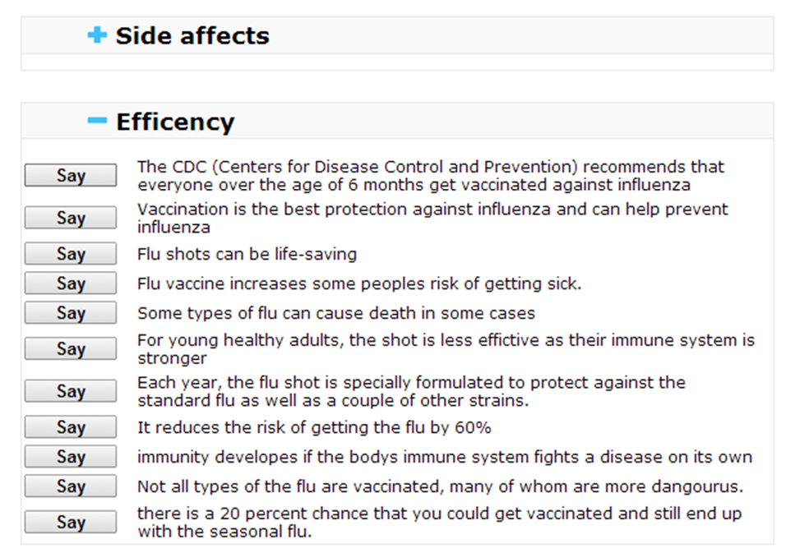
Chat Experiment
Collected 30 chats (60 participants) on “influenza vaccinations” using a structured chat.
Participants declared their opinion and were coupled.
Notes:
Most important was the declaration by the user.
Influential attributes very similar to previous experiments.

Slide 39
Influenza Vaccinations

Slide 40
How to incorporate bounded rationality in argumentation theory?
k-justification
Every argument is accepted under some (“legitimate”) k-distance pruning.
At least when k=0.
Can explain every selection.
publish
Exclusive
Important
Private person
He is a minister
He resigned
rejected

Slide 41
Recommendation Policies
How should the suggestions be presented?
Should suggest the predicted arguments?
How to maintain a good hit-rate while offering novel arguments?

Slide 42
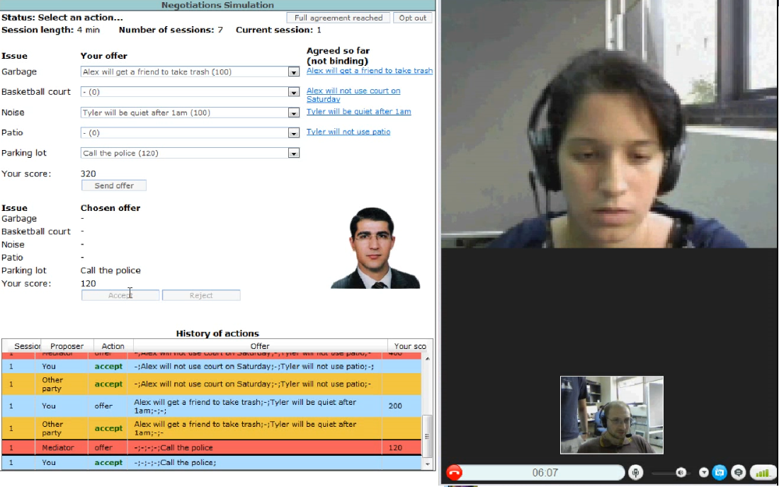
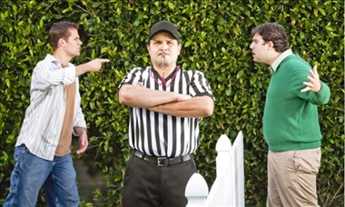
Automated Mediators for Resolving Conflicts
Bargaining

Slide 43
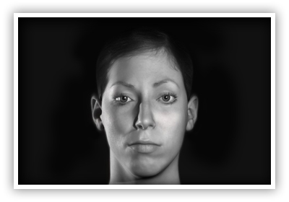
הדגמת הVH

Slide 44
Virtual Suspect (VS)
Database of personalized information
Family status, employment history, friends, criminal history
Events
Relevant event, non-relevant events [can be generate automatically]
Personality type and state

Slide 45
Psychology Based Virtual Suspect (VS) State Model
Cognitive load
Emotional Load
Attitude of the VS toward the investigator
Self-Control
Eysenck’s personality factors
High | 0------[---X-][--] 100 | Low | Cognitive
High | 0 ---[-X-]--[---]- 100 | Low | Emotional
Dependent | 0----[-X-]-[------] 100 | Antegonizm | Attitude
High | 0 --[--]---[-X-]-- 100 | Low | Control
Notes:
Mild cerebral palsy

Slide 46
The Process of Answering a Question
Question
VS State
Decision Making
Process
(randomization)
Possible answers
Data Base, history, Alibi,
Hot spots, Legal Access
Answer, Emotional state
Behavioral
Model

Slide 47
Psychological module: state matrix
 | סוג הגירוי | A⁴ Control | A³ Attitude | A² Emotional | A¹ Cognitive
A | מסביר | +25 | +15 | +20 | +5
B | מברר | -5 | -5 | -10 | +20
C | מרגיע | +15 | +10 | +25 | 0
D | מעצים | +20 | -1 | +20 | -10
E | ניטראלי | +10 | +5 | +1 | 0
F | השוואתי | 0 | -5 | 0 | +20
G | מאתגר | +5 | 0 | -1 | +25
H | מטיח | -10 | -10 | +5 | -5
I | מתריס | -10 | -20 | +15 | -10
J | מאיים | -20 | -25 | +20 | +15
K | מעליב | -10 | -25 | +25 | -20

Slide 48
Conclusions
Incorporating ML in argumentation is needed for investigating argumentation in the actual world.
Other aspects of argumentation besides acceptance should be explored.
Taking the human limitations and biases in consideration is a good practice for application development.

Slide 49
Current and future work
Implementing a recommendation agent (CYRANO) which explorers deferent recommendation policies.
Free-form chat experimentation using recommendations from CYRANO.
User-modeling for over-time multiple uses of the system.
Can we learn past chats to future ones?

