Slide 1
When Is it Beneficial to Develop Culture Sensitive Negotiation Agents*? Sarit Kraus Dept of Computer Science Bar-Ilan University Israel
*Culture sensitive agent – takes the culture of the
other agent into consideration when making decisions.
sarit@cs.biu.ac.il
http://www.cs.biu.ac.il/~sarit/

Slide 2
Motivation: e-commerce
Buyers and seller across geographical and ethnic borders
electronic commerce:
crowd-sourcing:
deal-of-the-day applications:
Interaction between people from different countries
Notes:
There are many application that make negotiation between people from different cultures. The issue here is build an agent that will know how to handle with this issue. And our hypothesis is that in order to succeed, the agent must take into account the culture issue when making negotiation.

Slide 3
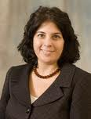
Motivation: Study of Cross Culture Negotiations
The development of a standardized agent to be used in studies in negotiation across cultures

Slide 4
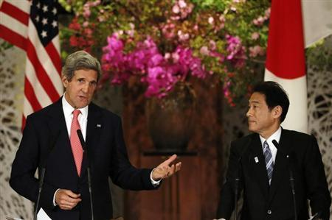
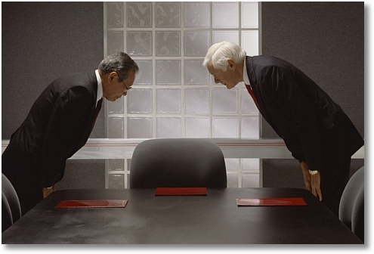
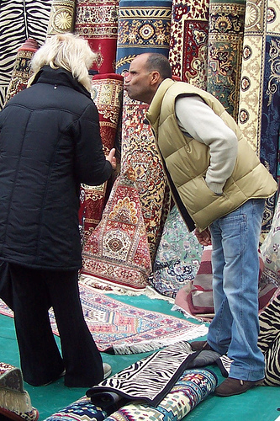
Motivation: Training People
Notes:
There are many application that make negotiation between people from different cultures. The issue here is build an agent that will know how to handle with this issue. And our hypothesis is that in order to succeed, the agent must take into account the culture issue when making negotiation.

Slide 5
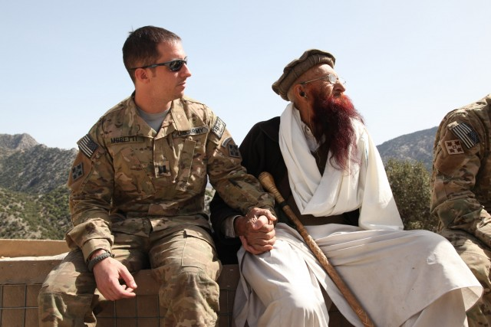
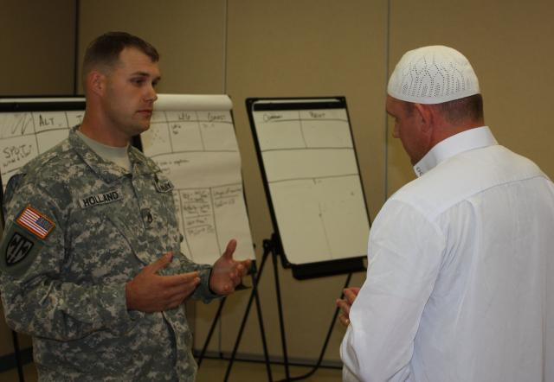
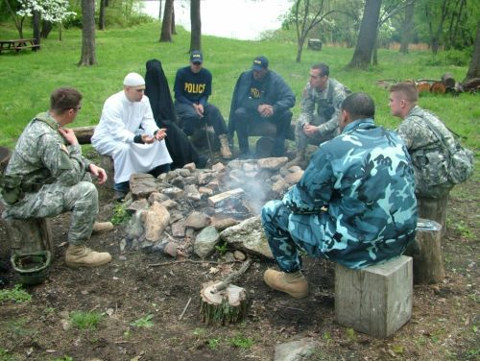
Motivation: Training People
Notes:
There are many application that make negotiation between people from different cultures. The issue here is build an agent that will know how to handle with this issue. And our hypothesis is that in order to succeed, the agent must take into account the culture issue when making negotiation.

Slide 6
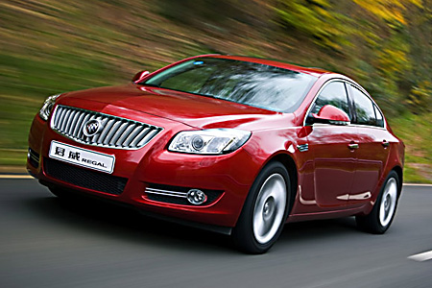
Persuasion: Intelligent Agents for Reducing Fuel Consumption
Notes:
Fun; advise to be sustainability

Slide 7
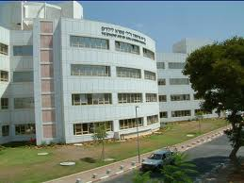
Persuasion: Medical Applications: Rehabilitation & Care
Reinforcement for rehabilitation in an inpatient rehabilitation unit
Personalized automated speech therapist
7
Sheba Hospital

Slide 8
When Is it Beneficial to Develop Culture Sensitive Negotiation Agents?

Slide 9
Plan of Talk
Multi-issue negotiation: US vs Israel
Keeping agreements in negotiation: US vs Israel vs Lebanon
Corruption: US vs Israel vs China
Making commitment: US vs Israel vs China

Slide 10
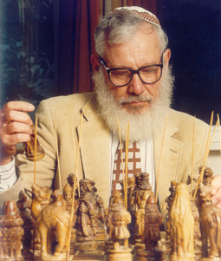
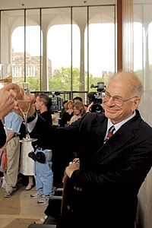
Why not Equilibrium Agents? No Need for Culture Consideration
Nash equilibrium: stable strategies; no agent has an incentive to deviate.
Results from the social sciences suggest people do not follow equilibrium strategies:
Equilibrium based agents played against people failed.
People do not build agents that follow equilibrium strategies.
Aumann
Kahneman

Slide 11
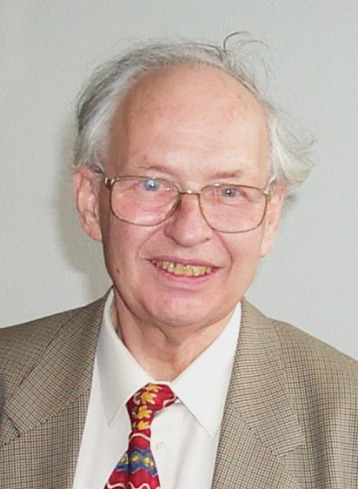
People Often Follow Suboptimal Decision Strategies
Irrationalities attributed to
sensitivity to context
lack of knowledge of own preferences
the effects of complexity
the interplay between emotion and cognition
the problem of self control
All sensitive to culture (Henrich et al 1999)
Selten
Kahneman

Slide 12
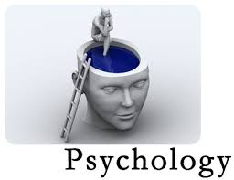
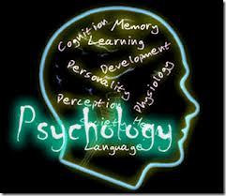
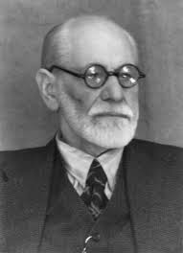
Why not Only Behavioral Science Models?
There are several models that describe human decision making and are culture sensitive
Most models specify general criteria that are context sensitive but usually do not provide specific parameters or mathematical definitions

Slide 13
Linguistic differences in “Getting to Yes” in Egyptian and American Dyads (Gelfand et al, in prep)
Integrative Outcomes Positively predicted by: | Integrative Outcomes Negatively predicted by:
In EGYPT: Honor talk (Integrity, honest, trust) Assent (e.g., yes, agree, OK) Focus on relationships (e.g., partner, society, family) | In EGYPT Appeals to facts, reasons, cognition (cognitive mechanism) Negate (e.g., no) Demonstrations of Superiority and social standing (e.g., fame, status) Focus on time
In the U.S.: Appeals to facts, reasons, cognition (cognitive mechanism) | In the U.S. Focus on positions Work (e.g., profit, contract)
Notes:
“Getting to yes” positively predicted by honor talk related to society (e.g., partner, relationship), integrity (e.g., honest, trust), and assent (i.e., saying “yes)
Consistent with relational focus, demonstration of integrity
Negatively predicted by emphasis on logic, reason, appeals to facts (cognitive mechanisms dictionary) as well as negatively prediced by expressions of status/superiority from our honor dictionary and focus on time
In the U.S. consistent with individualistic cultures and recommendations to separate the people from the problem and use logic, appeals to facts, reactions, cognition were POSITIVELY related to actual negotiation outcomes. In the U.S. a focus on money and positions were negatively related to outcomes, which is also consistent with Getting to Yes recommendations to focus on underlying interests versus positions.
So in all, honor talk matters in negotiations—it is very importnt in Egypt in particular as we expected.

Slide 14
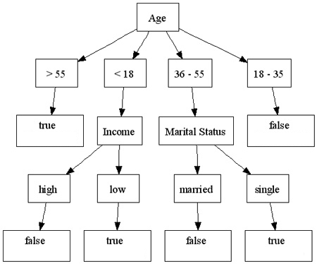
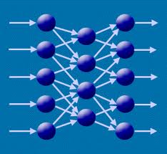
Why not Only Machine Learning?
Machine learning builds models based on data
It is difficult to collect human data
Collecting data on a specific user is very time consuming.
Human data is noisy and across cultures is even more noisy
Collecting data from different cultures is very challenging
“Curse” of dimensionality
Notes:
קללת ריבוי המימדים

Slide 15
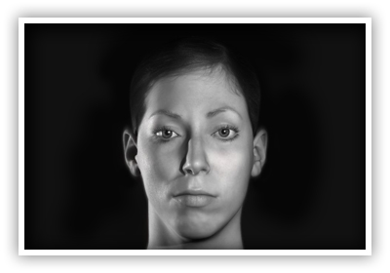
Methodology & Open Questions
(Culture?) Human behavior models
Data (from specific culture?)
Machine Learning
Human specific data
Game Theory Optimization
methods
Human Prediction Model
Take action

Slide 16
Multi-issue Negotiation: The Negotiation Scenario
Employer and job candidate
Objective: reach an agreement over hiring terms after successful interview

Slide 17
KBAgent [OS09]
Multi-issue, multi-attribute, with incomplete information
Domain independent
Implemented several tactics and heuristics
qualitative in nature
Non-deterministic behavior, also via means of randomization
Using data from previous interactions (ML)
Menu Driven Negotiation
Y. Oshrat, R. Lin, and S. Kraus. Facing the challenge of human-agent negotiations via effective general opponent modeling. In AAMAS, 2009

Slide 18
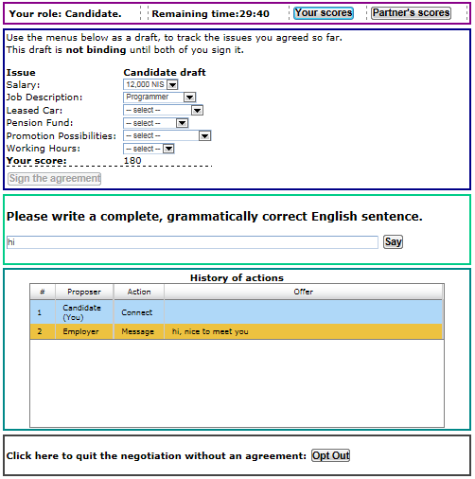
Chat-Based
Negotiation
Genius: Delft & BIU

Slide 19
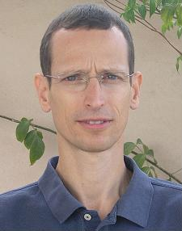
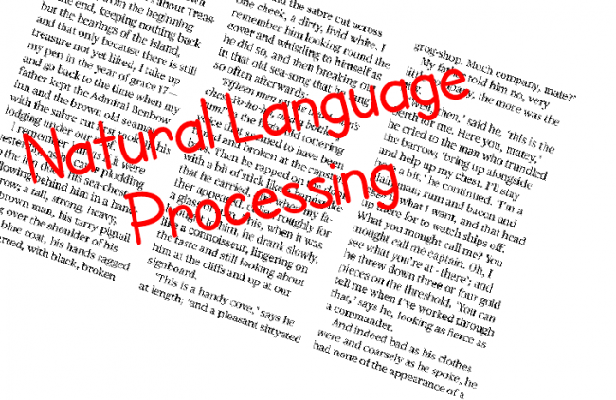
NegoChat
Modifying existing agents to include an NLP module is insufficient; need to address partial agreements and issue-by issue interactions
NegoChat is based on Aspiration Adaptation Theory (BS)
Issues are addressed based on people’s typical urgency (ML)

Slide 20
NegoChat vs KBagent in Israel

Slide 21
KBAgent(US) vs KBAgent(Israel) in US
People in Israel and US perform similarly.
KBAgent(US) performs slightly better than the KBAgent(Israel) (not significant)
People playing with the KBAgent(US)
did significantly better ,
reached agreements significantly faster ,
higher social welfare
People thought KBAgent(US) is fairer and were happier with their agreements

Slide 22
NegoChat vs KBagent(US) in US
No significant different with opt out.
NegoChat obtained significantly higher score considering only agreements.
People did better when negotiating with KBagent.
Agreement reached faster with KBagent.

Slide 23
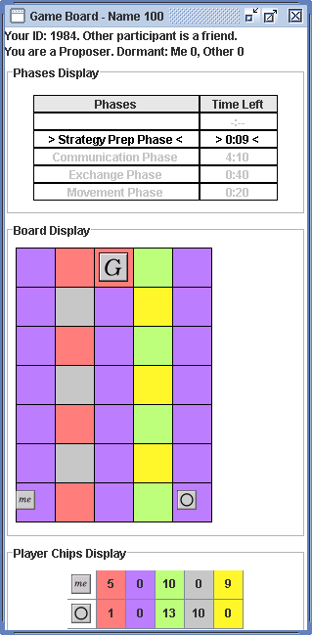
An Experimental Test-Bed
Interesting for people to play:
analogous to task settings;
vivid representation of strategy space (not just a list of outcomes).
Possible for computers to play.
Can vary in complexity
repeated vs. one-shot setting;
availability of information;
communication protocol;
Negotiations and teamwork
23

Slide 24
CT Game
100 point bonus for getting to goal
10 point bonus for each chip left at end of game
Agreement are not enforceable
Collaborators: Gal, Gelfand
24
Notes:
if I

Slide 25
The PURB-Agent
Rules!!
Agent’s
Cooperativeness
& Reliability
Estimations of others’
Cooperativeness
& Reliability
Taking into consideration
human factors
Social Utility
Expected value
of action
Expected
ramification
of action

Slide 26
Hypothesizes
People in the U.S. and Lebanon would differ significantly with respect to cooperativeness:
helpfulness trait:
reliability trait:
An agent that modeled and adapted to the cooperativeness measures exhibited by people will play at least as well as people

Slide 27
PURB vs People in Lebanon & US

Slide 28
Reliability Measures
Average | Task dep. | Task indep. | Co-dep
0.92 | 0.87 | 0.94 | 0.96 | People (Lebanon)
0.65 | 0.51 | 0.78 | 0.64 | People (US)

Slide 29
Reliability Measures
Average | Task dep. | Task indep. | Co-dep
0.98 | 0.99 | 0.99 | 0.96 | PURB (Lebanon)
0.62 | 0.72 | 0.59 | 0.59 | PURB (US)

Slide 30
Reliability Measures
Average | Task dep. | Task indep. | Co-dep
0.98 | 0.99 | 0.99 | 0.96 | PURB | Lebanon
0.92 | 0.87 | 0.94 | 0.96 | People
0.62 | 0.72 | 0.59 | 0.59 | PURB | US
0.65 | 0.51 | 0.78 | 0.64 | People

Slide 31
Reliability Measures
Average | Task dep. | Task indep. | Co-dep
0.98 | 0.99 | 0.99 | 0.96 | PURB | Lebanon
0.92 | 0.87 | 0.94 | 0.96 | People
0.62 | 0.72 | 0.59 | 0.59 | PURB | US
0.65 | 0.51 | 0.78 | 0.64 | People

Slide 32
Learning culture vs Programming ahead of Time
Can we build an agent that will be better than the people it plays with in all countries?
Can we build proficient negotiator with no expert designed rules?
New rules?
Rules that are culture sensitive?
Learning weights of social utility from data?
Can we build prediction model?
Should we build prediction model for each culture?

Slide 33
Personality, Adaptive Learning (PAL) Agent
Data from specific culture
Machine Learning
Human specific data
Game Theory Optimization
methods
Human Prediction Model
Take action
Collaborators: Haim, Gal, Gelfand

Slide 34
Personality, Adaptive Learning (PAL) Agent
In this data set the Lebanon people almost always kept the agreements ➔ PAL never kept agreements
Data from specific culture
Machine Learning
“Nasty Agent”: Less reliable when fulfilling its agreement
Game Theory Optimization
methods
People adapt their behavior to their counterparts.
Human Prediction Model
Take action

Slide 35
Pal vs Humans
Notes:
Reports performance (in average score per game) for each of the countries and for each dependency condition
The best performance for PAL and the worst performance for people occurred in the U.S
PAL was able to outperform people in all dependency conditions and in all countries

Slide 36
Open Questions
Is it possible to develop new innovative learning algorithms that will allow us to learn from one culture to another when the cultures are significantly different? Can we introduce adaptation method to counterparts?
Collaborator: Kobi Gal, Avi Rosenfeld

Slide 37
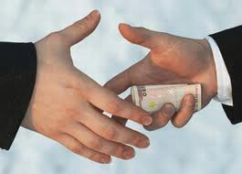
A Study of Corruption in Different Cultures
Corruption is an important policy concern in many countries
Difficult to model and to predict in the confinements of the laboratory
Collaborators: Gal, An, Rosenfeld, Gelfand

Slide 38
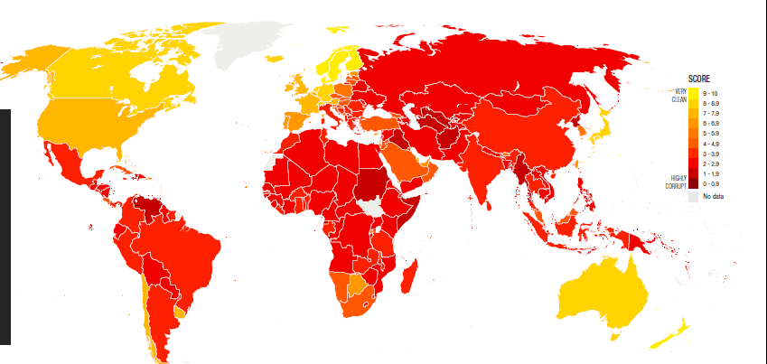
Corruption Index
Global index is a perceived measure (the lower the better):
USA: rank 19
Israel: rank 36
China: rank 80

Slide 39
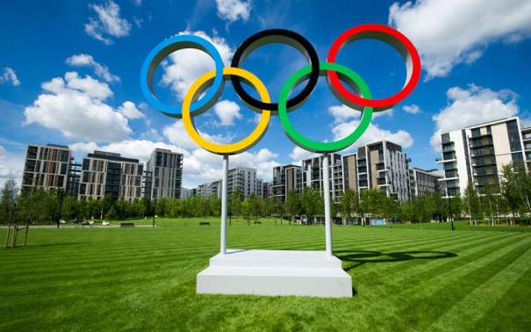
The Olympic Game
A board game providing an analogy to group decision-making in the real world
Three bidders compete to win contracts by submitting bids in repeated auctions
One Auctioneer determines the winner
Rules are completely open-ended. Players can exchange resources and messages privately

Slide 40
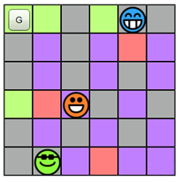
The Game Board
Reaching the goal = Earn the right to carry out projects
I’m Bidder 1
I’m Bidder 3

Slide 41
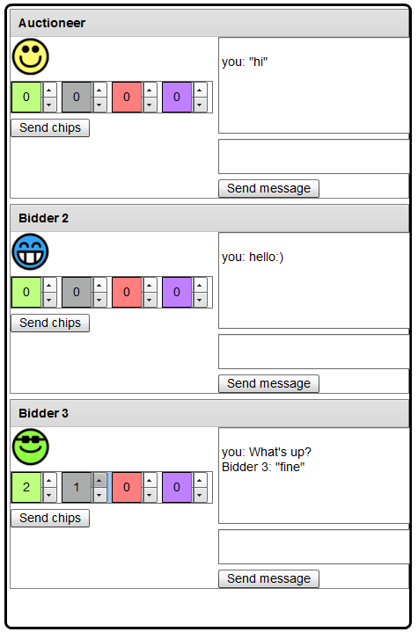
Exchanging Phase
In this phase all players can exchange messages or send chips to any other player
Messages and chip exchange are private and not observed by other players
You can send chips to a player. In this example the player is about to send 2 green chips and 1 gray to Bidder #3
You can send a private message to a player

Slide 42
Score
Players get 1 point for every chip they have left at the end of the round
If the auction winner can reach the goal, he gets 100 points bonus
The auctioneer gets 5-points bonus if the winner is able to reach the goal
The winning bid is paid to the government, not the auctioneer

Slide 43
Corruption Definition
Bidder chosen by auctioneer despite submitting a lower bid.
Defining Communication between bidder and auctioneer (may be initiated by either player).
Bidder pays auctioneer in return for getting chosen.

Slide 44
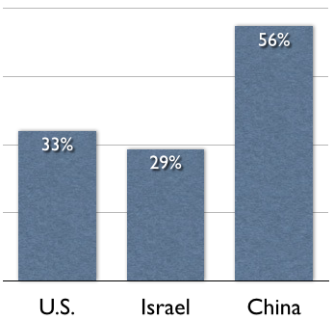
Frequency of Corruption
* Number of corruption instances increased in last rounds!
Notes:
Highest corruption level in China (not surprising), followed by US and Israel.
The difference between China and U.S. is surprising given the lower CPI level in U.S. than in Israel.
Number of corruption instances increased in last rounds of play (but there was no significant correlation between round number and corruption).

Slide 45
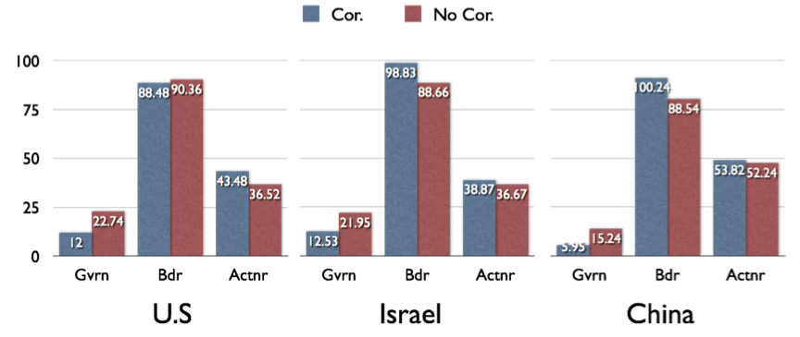
Score Comparison
Easy to predict if corruption
occurs from government profit
* More corruption in China, but winning bidders earn less!
Notes:
As expected, corruption decreases the total government score in each country.
Similar trends can be seen in China and Israel, with U.S. being surprisingly different.
The auctioneer significantly benefited from corruption in the U.S., but not in China and in Israel.
Winning bidders significantly benefited from corruption in Chin and

Slide 46
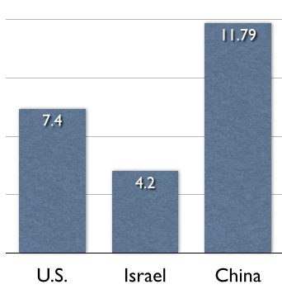
Bribery Amounts
Notes:
To explain this result we analyze the amount of chips sent by the winning bidder in each country; as can be seen the bribery in China is significantly (unnessarily) higher than in the other countries.

Slide 47
Corruption Game – Open Questions
Can we build a (culture sensitive?) agent playing the game?
Can we change the game to prevent corruption?
Should the game change be different for each country?

Slide 48
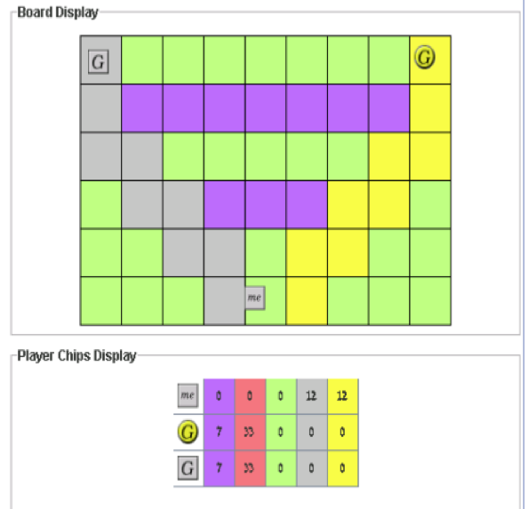
The Contract Game (3 Players)
Players: Two Internet service providers (SPs) and one customer (CS)
The SPs are competing to get a contract with the CS
Each SP provider is willing to be the customer’s exclusive provider
Collaborators: Haim, Gal, An, 2014

Slide 49
Equilibrium Agent
Commitment offer: bind the customer to one of the SP for the duration of the game
SPs compete over the CS; offer highly beneficial to the CS
11 grays for 33 reds and 7 purples

Slide 50
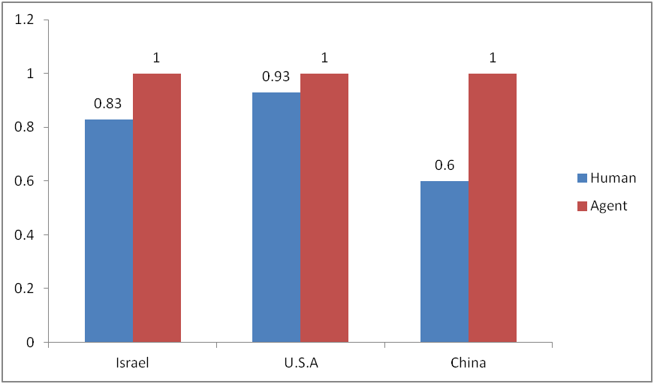
Human are Bounded rational: Do not Reach the Goal

Slide 51
CS EQ Agent vs Human Score

Slide 52
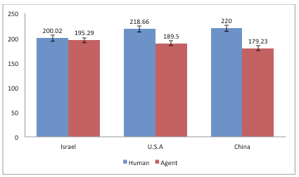
SP Yellow EQ Agent vs Human

Slide 53
China vs USA vs Israel
CS players in China reached the goal significantly
less often than in Israel and U.S.A
Players in China played differently in H vs H games compared to H vs Agent games
Number of very short games in Israel and china much higher than in USA – are the USA subjects better players?
CS in China are less generous than CS in Israel & USA

Slide 54
Games Ending with Commitments

Slide 55
SP Yellow EQ Agent vs Human
Can we develop culture strategies? What should be the optimization problem?

Slide 56
Uncertainty when Attempting to Move
Assumption – when a human player attempt to go to the goal, there is some probability p that he will fail.
Risk-Averse Agent – culture sensitive with respect to probability failure?

Slide 57
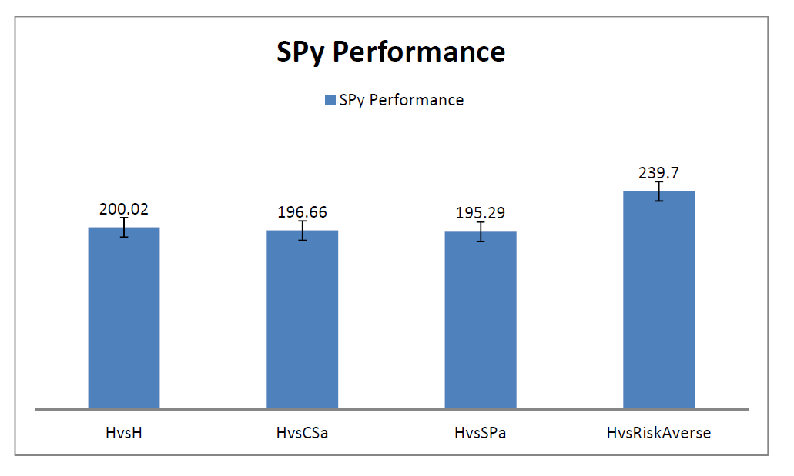
Risk Averse Agent Results in Israel

Slide 58
Conclusions and Challenges
If the cultures are different enough, it seems worth building culture sensitive agents.
What is the best decision making procedure for culture sensitive agents?
For human modeling: many examples are needed.
Is it possible to develop new ML method to learn from one culture to the other?
How should the culture based model be used in the agent decision making?
We need procedures and methodologies to run cross cultures experiments.

Slide 59
Conclusions
Human behavior models
Data (from specific culture)
Machine Learning
Game Theory Optimization
methods
Human Prediction Model
Take action

