Slide 1
Culture Sensitive Negotiation Agents Sarit Kraus Dept of Computer Science Bar-Ilan University
sarit@cs.biu.ac.il
http://www.cs.biu.ac.il/~sarit/

Slide 2
Motivation: e-commerce
Buyers and seller across geographical and ethnic borders
electronic commerce:
crowd-sourcing:
deal-of-the-day applications:
Interaction between people from different countries
➔ to succeed, an agent needs to reason about how culture affects people's decision making
Notes:
There are many application that make negotiation between people from different cultures. The issue here is build an agent that will know how to handle with this issue. And our hypothesis is that in order to succeed, the agent must take into account the culture issue when making negotiation.

Slide 3
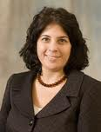
Motivation: Study of Cross Culture Negotiations
The development of a standardized agent to be used in studies in negotiation across cultures

Slide 4
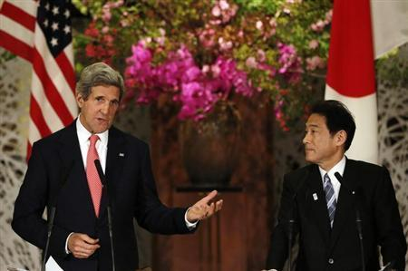
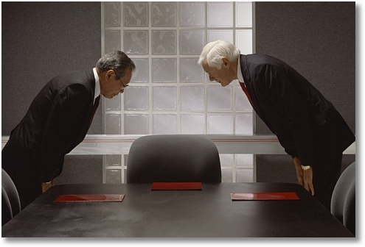
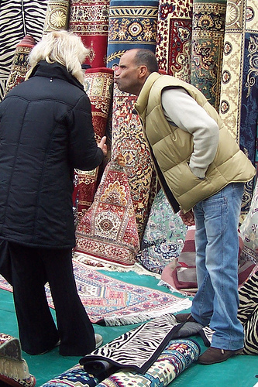
Motivation: Training People
Notes:
There are many application that make negotiation between people from different cultures. The issue here is build an agent that will know how to handle with this issue. And our hypothesis is that in order to succeed, the agent must take into account the culture issue when making negotiation.

Slide 5
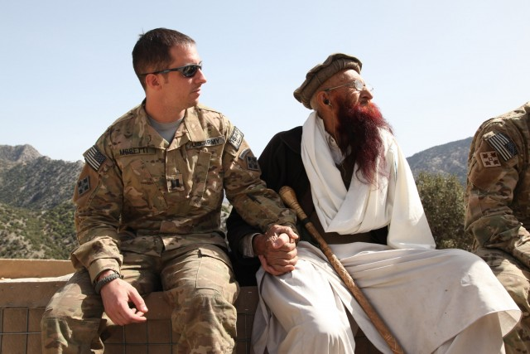
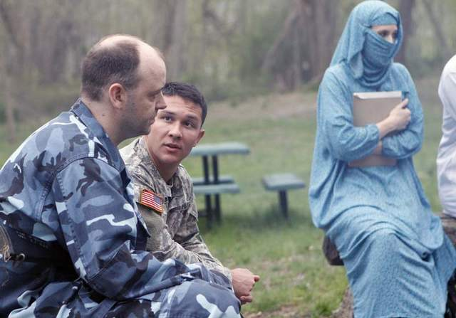
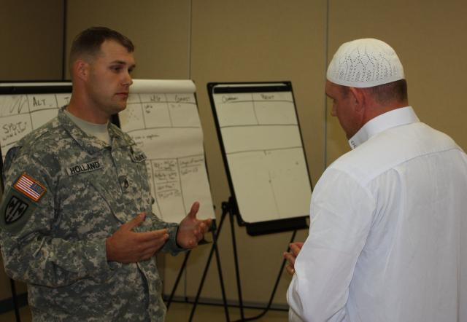
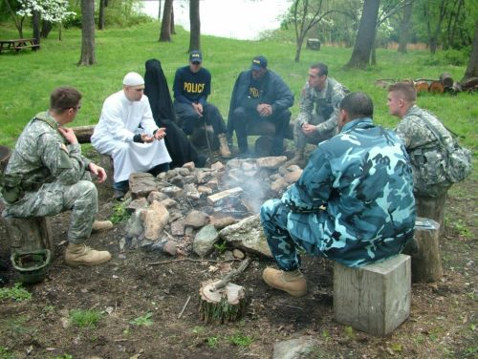
Motivation: Training People
Notes:
There are many application that make negotiation between people from different cultures. The issue here is build an agent that will know how to handle with this issue. And our hypothesis is that in order to succeed, the agent must take into account the culture issue when making negotiation.

Slide 6
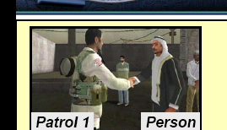
Security Applications

Slide 7
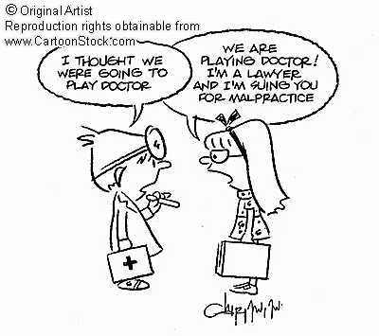
Can Automated Agents be Used for Negotiation Training?
Simulations and role-playing are extensively used for training people
Underlying assumption: they improve people’s negotiation skills
Do they really?
Can automated agent help?
accessible and available 24/7
modeling different counterparts
Notes:
other examples: virtual humans

Slide 8
KBAgent [OS09]
Multi-issue, multi-attribute, with incomplete information
Domain independent
Implemented several tactics and heuristics
qualitative in nature
Non-deterministic behavior, also via means of randomization
Using data from previous interactions
Y. Oshrat, R. Lin, and S. Kraus. Facing the challenge of human-agent negotiations via effective general opponent modeling. In AAMAS, 2009

Slide 9
The Negotiation Scenario
Employer and job candidate
Objective: reach an agreement over hiring terms after successful interview

Slide 10
Results
Compared to the control group:
better
sig.
better
Method | Role | Average Utility
Control group | Emp. | 431.78
 | Job Can. | 320.5
Training via human nego. | Emp. | 448.56
 | Job Can. | 383.83
Training via automated nego. | Emp. | 468.6
 | Job Can. | 433

Slide 11
Example scenario
Culture dependent scenario
Employer and job candidate
Objective: reach an agreement over hiring terms after successful interview
Subjects could identify with this scenario

Slide 12
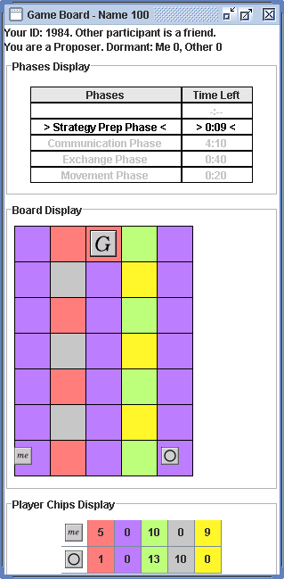
CT game
100 point bonus for getting to goal
10 point bonus for each chip left at end of game
Agreement are not enforceable
12
Notes:
if I

Slide 13
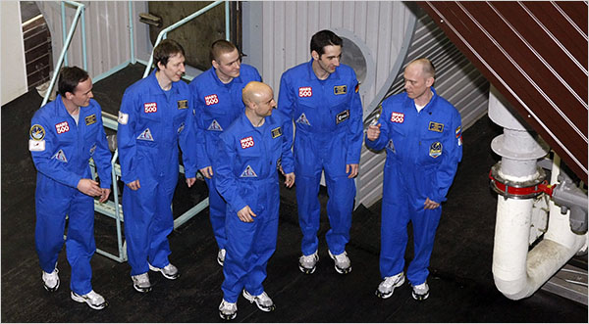
An Experimental Test-Bed
Interesting for people to play:
analogous to task settings;
vivid representation of strategy space (not just a list of outcomes).
Possible for computers to play.
Can vary in complexity
repeated vs. one-shot setting;
availability of information;
communication protocol;
Negotiations and teamwork
Perfect!!
Excellent!!
13

Slide 14
CT game
100 point bonus for getting to goal
10 point bonus for each chip left at end of game
Agreement are not enforceable
14
Notes:
if I

Slide 15
The PURB-Agent
Rules!!
Taking into consideration
human factors
Agent’s
Cooperativeness
& Reliability
Estimations of others’
Cooperativeness
& Reliability
Social Utility
Expected value
of action
Expected
ramification
of action

Slide 16
Hypothesis
People in the U.S. and Lebanon would differ significantly with respect to cooperativeness:
helpfulness trait:
reliability trait:
An agent that modeled and adapted to the cooperativeness measures exhibited by people will play at least as well as people

Slide 17
Average Performance

Slide 18
Reliability Measures
Average | Task dep. | Task indep. | Co-dep
0.92 | 0.87 | 0.94 | 0.96 | People (Lebanon)
0.65 | 0.51 | 0.78 | 0.64 | People (US)

Slide 19
Reliability Measures
Average | Task dep. | Task indep. | Co-dep
0.98 | 0.99 | 0.99 | 0.96 | PURB (Lebanon)
0.62 | 0.72 | 0.59 | 0.59 | PURB (US)

Slide 20
Reliability Measures
Average | Task dep. | Task indep. | Co-dep
0.98 | 0.99 | 0.99 | 0.96 | PURB (Lebanon)
0.92 | 0.87 | 0.94 | 0.96 | People (Lebanon)
0.62 | 0.72 | 0.59 | 0.59 | PURB (US)
0.65 | 0.51 | 0.78 | 0.64 | People (US)

Slide 21
Reliability Measures
Average | Task dep. | Task indep. | Co-dep
0.98 | 0.99 | 0.99 | 0.96 | PURB (Lebanon)
0.92 | 0.87 | 0.94 | 0.96 | People (Lebanon)
0.62 | 0.72 | 0.59 | 0.59 | PURB (US)
0.65 | 0.51 | 0.78 | 0.64 | People (US)

Slide 22
Average Performance

Slide 23
Goals and Challenges
Can we build an agent that will be better than the people it plays with in all countries?
It didn’t work!!
1. Collect data on each country
2. Use machine learning
3. Build influential diagram
4. Solve with backward induction
Can we build proficient negotiator with no expert designed rules?
Examples don’t cover the entire possibilities
Culture sensitive agent?
Examples are too noisy

Slide 24
Personality, Adaptive Learning (PAL) Agent
The Lebanon people in this data set almost always kept the agreements and as a result, PAL never kept agreements
Data from specific country
“Nasty agent”: less reliable when fulfilling its agreement
machine learning
Decision Making
Human behavior model
Take action
24
Notes:
Say!!! We learned specific models for people behavior in each country we played with.
Explain that we tested many machine learning algorithms on the same test bed and we took the ones that gave us the less mean root square error.

Slide 25
Success Rate: Getting to the Goal
Notes:
Emphasize here that it’s about Performance
As shown in the figure, PAL was also able to reach the goal significantly more often than people in all dependency conditions and in all countries.
These results are also supported when analyzing the number of times PAL got to the goal: For all dependency conditions, PAL was able to get to the goal significantly more often in the U.S. than in Lebanon and Israel, and people were able to reach the goal significantly less often in the U.S. than in Lebanon and Israel.
The reason that PAL was not so good as expected in Lebanon is the PAL problem, didn’t adapt its strategy so well to the Lebanon people (maybe if PAL was more reliable in Lebanon, its result could be much higher in Lebanon…). And this is one of the future works…

Slide 26
Performance Comparison: Averages
Notes:
Reports performance (in average score per game) for each of the countries and for each dependency condition
The best performance for PAL and the worst performance for people occurred in the U.S
PAL was able to outperform people in all dependency conditions and in all countries

Slide 27
Example in Lebanon
2 chips for 2 chips; accepted → both sent
1 chip for 1 chip; accepted
PAL learned that people in Lebanon were highly reliable ➔PAL did not send, the human sent
games were relatively shorter
people were very reliable in the training games
27

Slide 28
Example in Israel
2 chips for 2 chips; accepted → only PAL sent
1 chip for 1 chip; accepted → the human only sent
1 chip for 1 chip; accepted → the human only sent
1 chip for 1 chip; accepted→ only PAL sent
1 chip for 3 chips; accepted→ only the human sent
people were less reliable in the training games than in Lebanon
games were relatively longer

Slide 29
PAL
PAL is able to learn to negotiate proficiently with people across different cultures
PAL was able to outperform people in all dependency conditions and in all countries
This is the first work to show that a computer agent can learn to negotiate with people in different countries

Slide 30
Automated Mediator Scenario: Neighbor Dispute
Alex and Tyler
Two renters
Always arguing
Sending complaint letters, calling police on each other
Jordan, the mediator

Slide 31
This does not look as a real person!!
Remove the Avatar!!

Slide 32
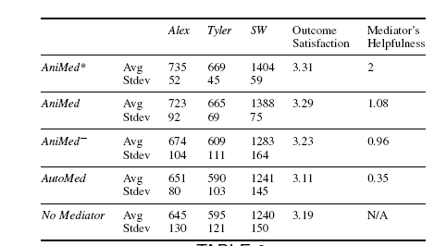
AniMed Evaluation

Slide 33
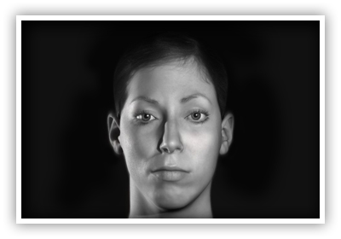
Conclusions
Data
(from specific culture)
Human behavior models
machine learning
Game Theory Optimization
methods
Human Prediction Model
Take action

