Slide 1


Intelligent Systems for Homeland Security
Sarit Kraus
Dept of Computer Science
Bar-Ilan University
Israel
sarit@cs.biu.ac.il
http://www.cs.biu.ac.il/~sarit/

Slide 2
Sarit Kraus
Head of the AIM Laboratory (14 graduate students; 4 programmers, 65 alumina)
Relevant research: The development of intelligent systems, intelligent agents that interact proficiently with people; home land security
Awards: IJCAI, IBM faculty, AAAI Fellow, ACM Agents award, 2 IFAAMAs influential papers, ECCAI Fellow, EMET, Adv. ERC, best papers award, LA home land security.
Author of 2 books and more than 350 papers

Slide 3
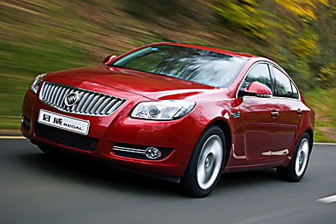
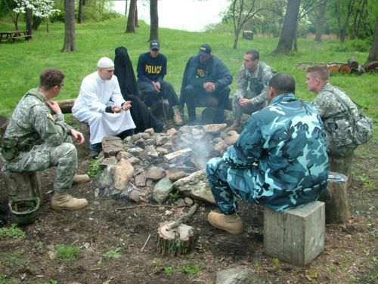
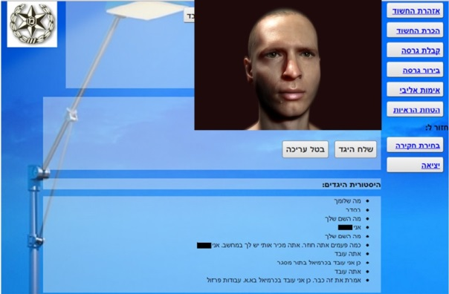








Sarit Kraus
Intelligent Agents that Interact Proficiently with People
Persuading people
to save energy
Training people in
negotiations
Virtual suspect for training investigators
Automated Speech Therapist
Automated
mediators
Culture sensitive
negotiation agent

Slide 4
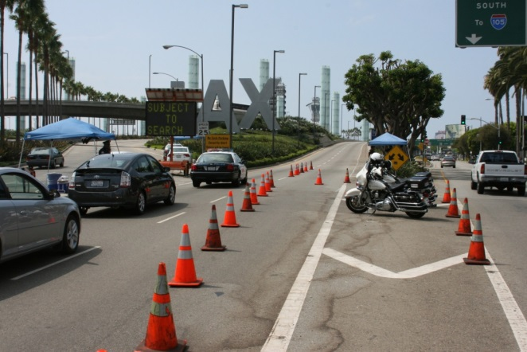

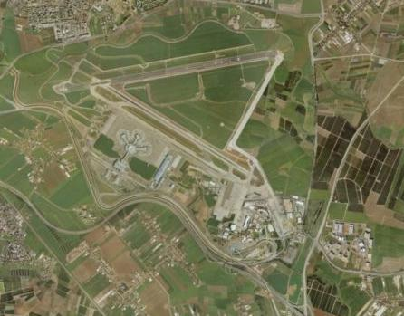
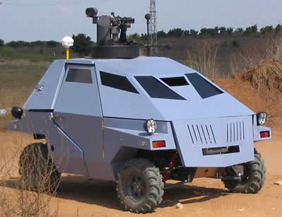
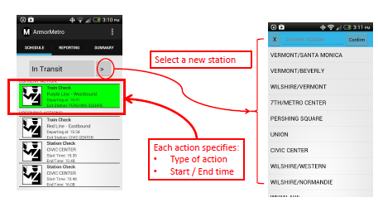
Sarit Kraus:
Robots and Homeland Security
Intelligent Randomized Checkpoints
Adversarial Patrolling
Randomized Routes for Crime suppression & ticketless travelers

Slide 5
Plan of the Tutorial
Introduction to Game Theory
Security Games for homeland security
Multi-robot patrolling
Introduction to Machine Learning
Innovative projects using game theory and machine learning
SLIDES: http://u.cs.biu.ac.il/~sarit/slides.html
Sarit Kraus/ Presentations

Slide 6

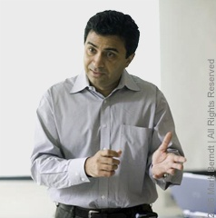
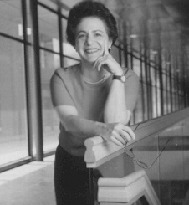
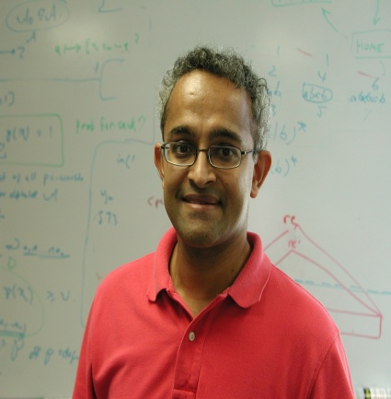
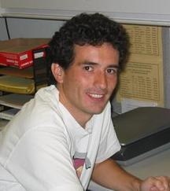



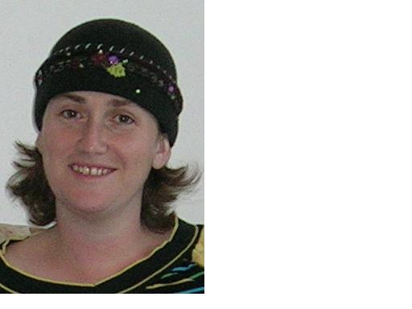

Collaborators
Gal Kaminka
Milind Tambe
Barbara Grosz
VS Subrahmanian
Fernando Ordonez
Noam Peled
Ariella
Richardson
Galit Haim
Michele Gelfand
Ya’akov Gal

Slide 7
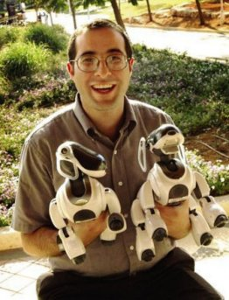

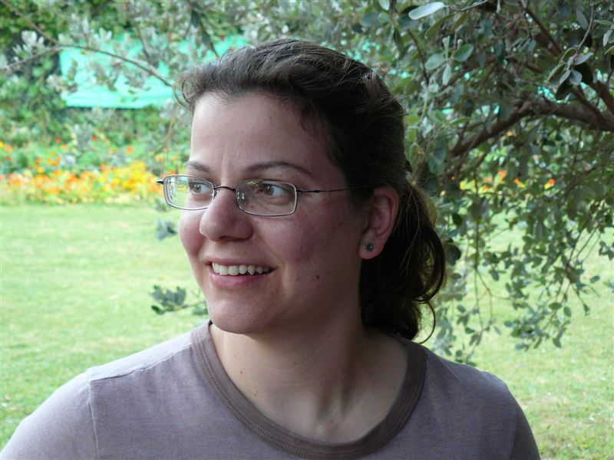

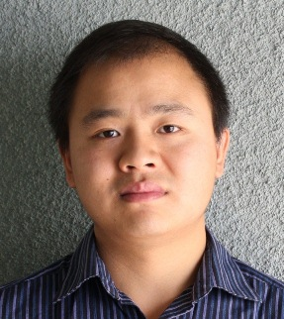





Collaborators
Ariel
Rosenfeld
Avi Rosenfeld
Yossi Keshet
Noa Agmon
Bo An
Praveen
Paruchuri
James Pita
Claudia
Goldman
Manish Jen
Amos Azaria
Moshe Bitan

Slide 8


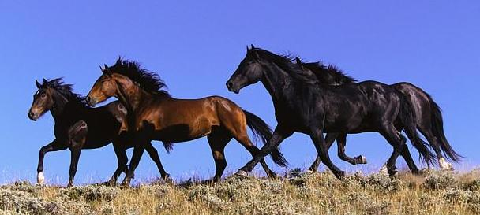
Physical Security with Bounded Resources
Limited security resources prevent full security coverage at all times; allows adversaries to observe and exploit patterns in selective patrolling or monitoring.
Randomized patrolling or monitoring is necessary.

Slide 9

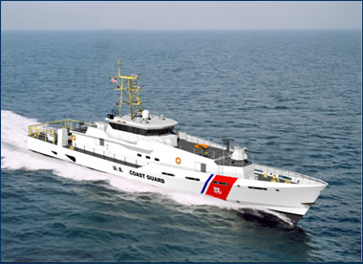
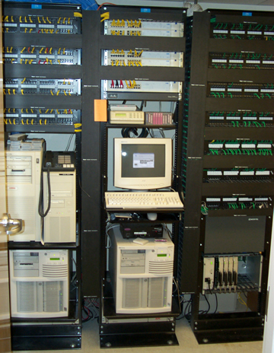

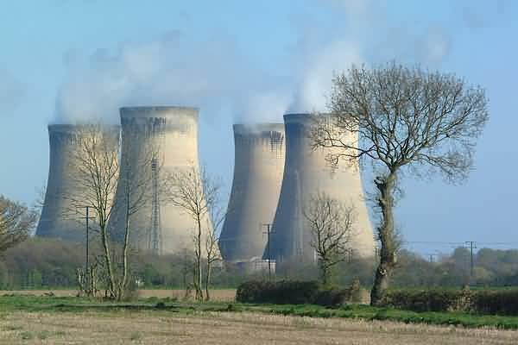
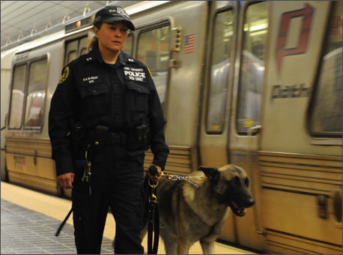
Many Targets Few Resources
How to assign limited resources
to defend the targets?
Game Theory
Notes:
Common challenge
Limited security resources: Selective checking
Adversary monitors defenses, exploits patterns

Slide 10
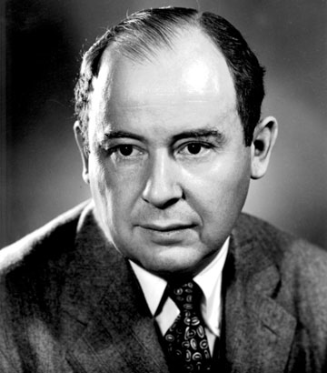
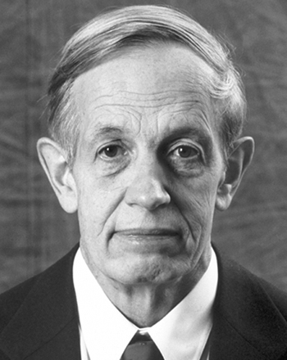
Game Theory
Mathematical framework
for multi-agent decisions
John von Neumann
John Nash
Economics, business, political science, biology,
computer science, psychology, law, urban planning…
Game theory provides a rigorous framework and
powerful set of tools for reasoning about decisions
in adversarial security domains

Slide 11
Short introduction to game theory
Game Theory studies situations of strategic interaction in which each decision maker's plan of action depends on the plans of the other decision makers.

Slide 12
Decision Theory (reminder)
(How to make decisions)
Decision Theory =
Probability theory + Utility Theory
  (deals with chance) (deals with outcomes)
Fundamental idea
  The MEU (Maximum expected utility) principle
  Weigh the utility of each outcome by the probability that it occurs

Slide 13
Basic Principle
Given probability P(out₁| A_{i}), utility U(out₁),
P(out₂| A_{i}), utility U(out₂)…
Expected utility of an action A_{i}i:
EU(A_{i}) = Σ U(out_{j})*P(out_{j}|A_{i})
Choose A_{i} such that maximizes EU
MEU = argmax Σ U(out_{j})*P(out_{j}|A_{i})
A_{i} ∈ Ac Out_{j} ∈ OUT
Out_{j} ∈ OUT

Slide 14
Risk Averse, Risk Neutral
Risk Seeking
RISK AVERSE
RISK NEUTRAL
RISK SEEKER

Slide 15
Game Description
Players
  Who participates in the game?
Actions / Strategies
  What can each player do?
  In what order do the players act?
Outcomes / Payoffs
  What is the outcome of the game?
  What are the players' preferences over the possible outcomes?

Slide 16
Game Description (cont)
Information
  What do the players know about the parameters of the environment or about one another?
  Can they observe the actions of the other players?
Beliefs
  What do the players believe about the unknown parameters of the environment or about one another?
  What can they infer from observing the actions of the other players?

Slide 17
Classification of Games
Depending on the timing of move
  Games with simultaneous moves
  Games with sequential moves
Depending on the information available to the players
  Games with perfect information
  Games with imperfect (or incomplete) information
We concentrate on non-cooperative games
  Groups of players cannot deviate jointly
  Players cannot make binding agreements

Slide 18
Games with Simultaneous Moves and Complete Information
All players choose their actions simultaneously or just independently of one another
There is no private information
All aspects of the game are known to the players
Representation by game matrices
Often called normal form games or strategic form games

Slide 19
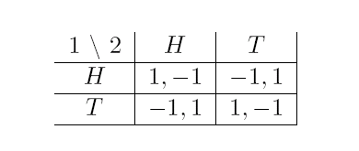
Matching Pennies
Example of a zero-sum game.
Strategic issue of competition.

Slide 20
Prisoner’s Dilemma
Each player can cooperate or defect
Column
cooperate
defect
cooperate
-1,-1
-10,0
Row
defect
0,-10
-8,-8
Main issue: Tension between
social optimality and individual incentives.

Slide 21
Coordination Games
A supplier and a buyer need to decide whether to adopt a new purchasing system.
Buyer
new
old
new
20,20
0,0
Supplier
old
0,0
5,5

Slide 22
Battle of sexes
Wife
football
shopping
football
2,1
0,0
Husband
shopping
0,0
1,2
The game involves both the issues of coordination and competition

Slide 23
Definition of Nash Equilibrium
A game has n players.
Each player i has a strategy set S_{i}
  This is his possible actions
Each player has a payoff function; S is S_1X S_2 X…S_n
  p_{I}: S →R
A strategy t_{i} in S_{i} is a best response if there is no other strategy in S_{i} that produces a higher payoff, given the opponent’s strategies

Slide 24
Definition of Nash Equilibrium
A strategy profile is a list (s₁, s₂, …, s_{n}) of the strategies each player is using
If each strategy is a best response given the other strategies in the profile, the profile is a Nash equilibrium
Why is this important?
  If we assume players are rational, they will play Nash strategies
  Even less-than-rational play will often converge to Nash in repeated settings

Slide 25
An Example of a Nash Equilibrium
Column
a
b
a
1,2
0,1
Row
b
2,1
1,0
(b,a) is a Nash equilibrium:
Given that column is playing a, row’s best response is b Given that row is playing b, column’s best response is a

Slide 26
Mixed strategies
Unfortunately, not every game has a pure strategy equilibrium.
  Rock-paper-scissors
However, every game has a mixed strategy Nash equilibrium
Each action is assigned a probability of play
Player is indifferent between actions, given these probabilities

Slide 27
Mixed Strategies
Wife
football
shopping
football
2,1
0,0
Husband
shopping
0,0
1,2

Slide 28
Mixed strategy
Instead, each player selects a probability associated with each action
  Goal: utility of each action is equal
  Players are indifferent to choices at this probability
a=probability husband chooses football
b=probability wife chooses shopping
Since payoffs must be equal, for husband:
  b*1=(1-b)*2 b=2/3
For wife:
  a*1=(1-a)*2 = 2/3
In each case, expected payoff is 2/3
  2/9 of time go to football, 2/9 shopping, 5/9 miscoordinate
If they could synchronize ahead of time they could do better.

Slide 29

Rock Paper Scissors
Column
rock
paper
scissors
rock
0,0
-1,1
1,-1
Row
paper
1,-1
0,0
-1,1
scissors
-1,1
1,-1
0,0

Slide 30
Setup
Player 1 plays rock with probability p_{r}, scissors with probability p_{s}, paper with probability 1-p_{r} –p_{s}
Utility₂(rock) = 0*p_{r} + 1*p_{s} – 1(1-p_{r} –p_{s}) =2 p_{s} + p_{r} -1
Utility₂(scissors) = 0*p_{s} + 1*(1 – p_{r} – p_{s}) – 1p_{r} = 1 – 2p_{r} –p_{s}
Utility₂(paper) = 0*(1-p_{r} –p_{s})+ 1*p_{r} – 1p_{s} = p_{r} –p_{s}
Player 2 wants to choose a probability for each action so that the expected payoff for each action is the same.

Slide 31
Setup
  q_{r}(2 p_{s} + p_{r} –1) = q_{s}(1 – 2p_{r} –p_{s}) = (1-q_{r}-q_{s}) (p_{r} –p_{s})
  It turns out (after some algebra) that the optimal mixed strategy is to play each action 1/3 of the time
  Intuition: What if you played rock half the time? Your opponent would then play paper half the time, and you’d lose more often than you won
  So you’d decrease the fraction of times you played rock, until your opponent had no ‘edge’ in guessing what you’ll do

Slide 32
Extensive Form Games
Any finite game of perfect information has a pure strategy Nash equilibrium. It can be found by backward induction.
T
H
H
T
T
H
(1,2)
(2,1)
(2,1)
(4,0)
Chess is a finite game of perfect information. Therefore it is a “trivial” game from a game theoretic point of view.

Slide 33
Extensive Form Games - Intro
A game can have complex temporal structure
Information
  set of players
  who moves when and under what circumstances
  what actions are available when called upon to move
  what is known when called upon to move
  what payoffs each player receives
Foundation is a game tree

Slide 34
Example: Cuban Missile Crisis
Nuke
- 100, - 100
Kennedy
Arm
Khrushchev
Fold
10, -10
-1, 1
Retract
Pure strategy Nash equilibria: (Arm, Fold) and (Retract, Nuke)

Slide 35
Subgame perfect equilibrium & credible threats
Proper subgame = subtree (of the game tree) whose root is alone in its information set
Subgame perfect equilibrium
  Strategy profile that is in Nash equilibrium in every proper subgame (including the root), whether or not that subgame is reached along the equilibrium path of play

Slide 36
Example: Cuban Missile Crisis
Nuke
- 100, - 100
Kennedy
Arm
Khrushchev
Fold
10, -10
-1, 1
Retract
Pure strategy Nash equilibria: (Arm, Fold) and (Retract, Nuke)
Pure strategy subgame perfect equilibria: (Arm, Fold)
Conclusion: Kennedy’s Nuke threat was not credible.

Slide 37
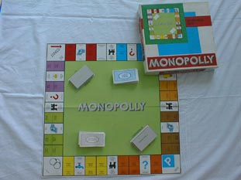
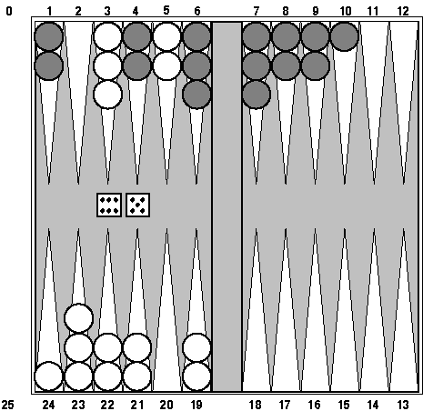
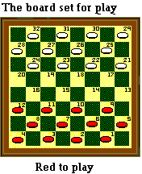
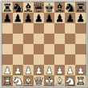
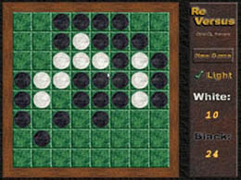

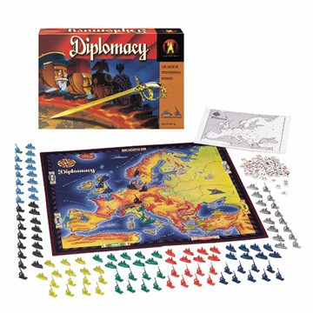
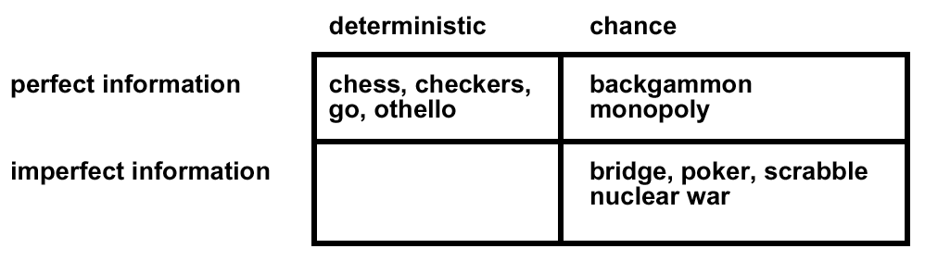
Type of games
Diplomacy

Slide 38


Security Games
Adversary
 | Terminal #1 | Terminal #2
Terminal #1 | 5, -3 | -1, 1
Terminal #2 | -5, 5 | 2, -1
Police
Notes:
P=3/13 ; q=3/5

Slide 39

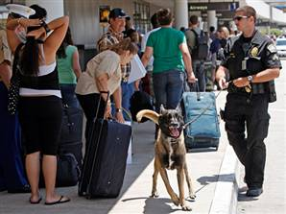
ARMOR: Deployed at LAX 2007
“Assistant for Randomized Monitoring Over Routes”
  Problem 1: Schedule vehicle checkpoints
  Problem 2: Schedule canine patrols
Randomized schedule: (i) target weights; (ii) surveillance
ARMOR-Checkpoints
ARMOR-K9

Slide 40

ARMOR (2009 Video)

Slide 41
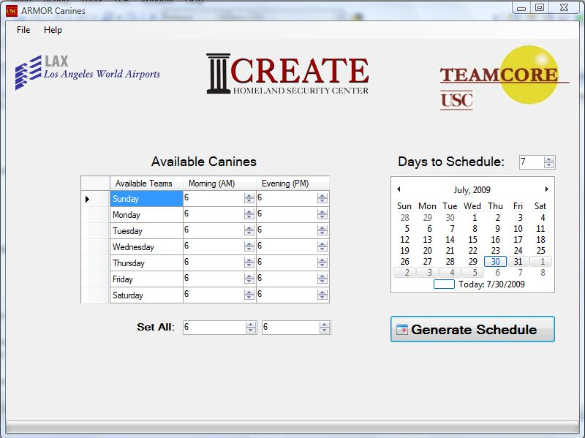
ARMOR Canine: Interface

Slide 43
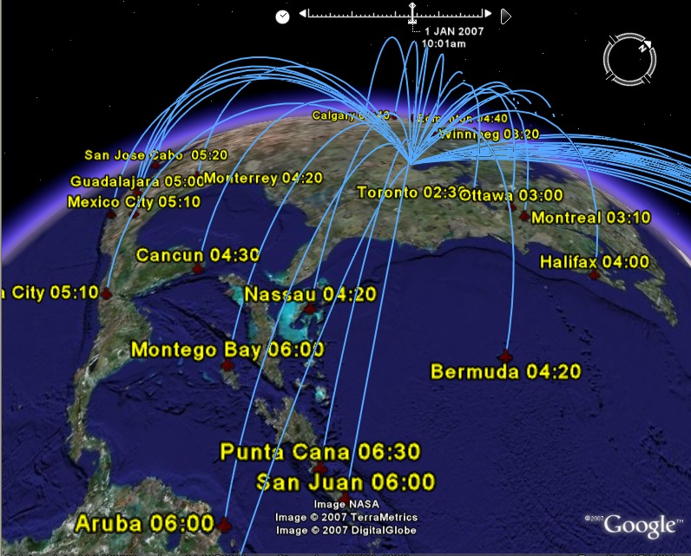
Federal Air Marshals Service (FAMS)
International Flights from
Chicago O’Hare
Undercover, in-flight
law enforcement
Flights (each day)
~27,000 domestic flights
~2,000 international flights
Not enough air marshals:
Allocate air marshals to flights?

Slide 44
Federal Air Marshals Service (FAMS)
Massive scheduling problem
Adversary may exploit predictable schedules
Complex constraints: tours, duty hours, off-hours
100 flights, 10 officers:
1.7 × 10¹³ combinations
Overall problem: 30000 flights, 3000 officers
USC focus: international sector

Slide 45

IRIS: “Intelligent Randomization in International Scheduling” (Deployed 2009)

Slide 46



PROTECT (Boston, NY and Beyond)
US Coast Guard: Port Resilience Operational / Tactical Enforcement to Combat Terrorism
Randomized patrols; deployed in Boston & NY, with more to follow
More realistic models of human behaviors
Notes:
Acronyms….
Challenges: scale-up, coordinating multiple defender units

Slide 47

Protecting Moving Targets: Ferries
Notes:
So first of all, how many of you have ever heard of the staten island ferry in New York City? Great!

Slide 48
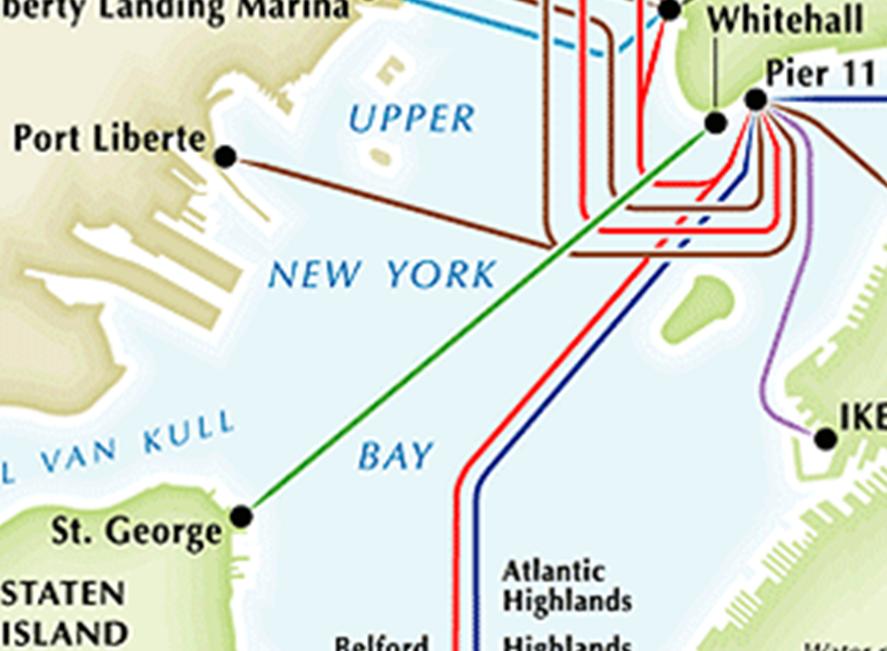

Protecting Moving Targets: Ferries
Protecting ferries with patrol boats
  Staten Island Ferry: over 20 million people a year (60,000 passengers a day on weekdays)
Protecting refugee aid convoys with helicopters
Notes:
Protecting this kind of ferries is actually a major example domain that motivates our work. The ferries are packed with hundreds of passengers and play an important role in the transportation network. For example, the Staten Island Ferry that provides a crucial link between Manhattan and Staten Island, carries over 20 million people a year and roughly 60,000 passengers a day on weekdays. So the ferries may be attractive to adversaries and they are under the threat of attack. For example, a ferry may be attacked by a small boat packed with explosives that may be only detected once it gets close to the ferry. To deal with the potential attacks, the US Coast Guard has several small, fast patrol boats, as shown in the blue circle, that can provide protection to such ferries, but there are often limited numbers of patrol boats, so it comes to the question of how to allocate the boats and what is the optimal patrol strategy?
Other domains such as protecting refugee aid convoys with overhead helicopters are faced with the similar challenge.

Slide 49

Protecting Ferries: Deployment
Notes:
Before we go to the final slide of the presentation, let me show you a first hand video we get last week from US Coast Guard, of how our approach is deployed to protect the staten island ferry. This video is taken on a ferry heading for Manhattan in the morning and we can see the patrol boat is close to the ferry and then make a nice turn to continue protecting the ferry. So next time when you have a chance to take the Staten Island Ferry, you may take a look at the patrol boats that are moving around to protect you.

Slide 50

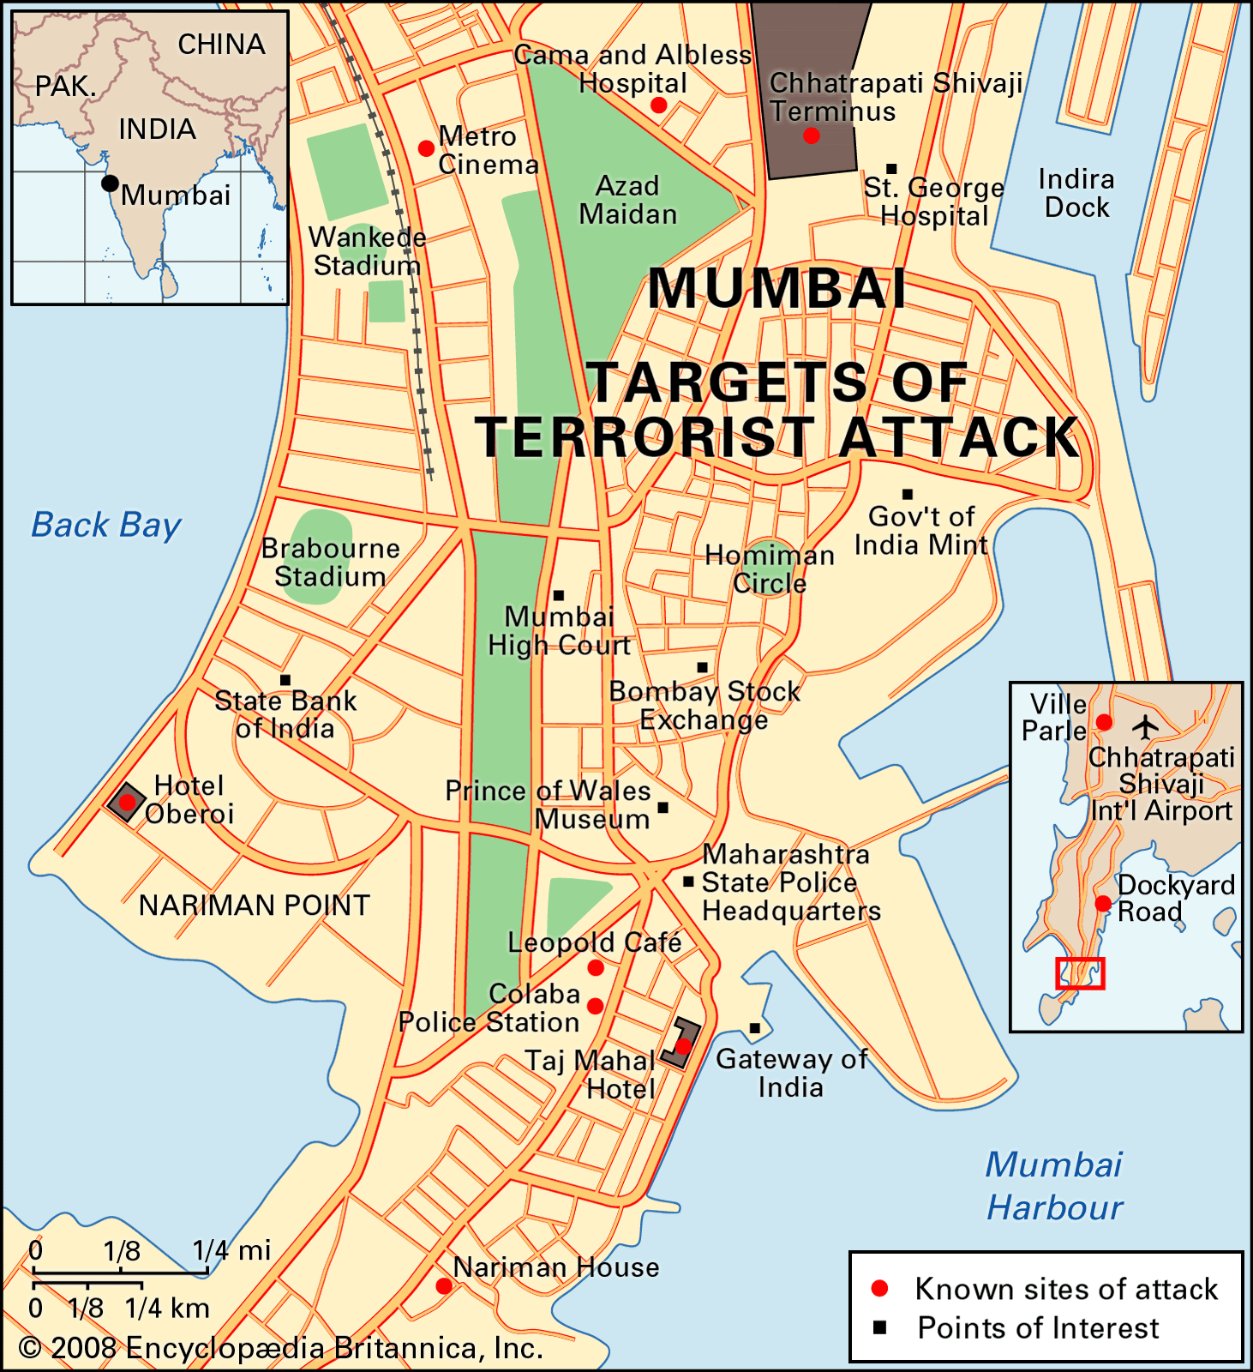
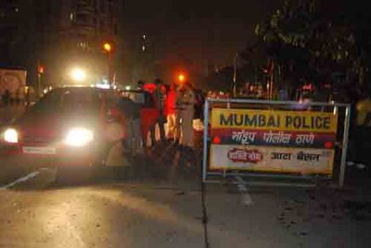
Mumbai
Protect networks

Slide 51
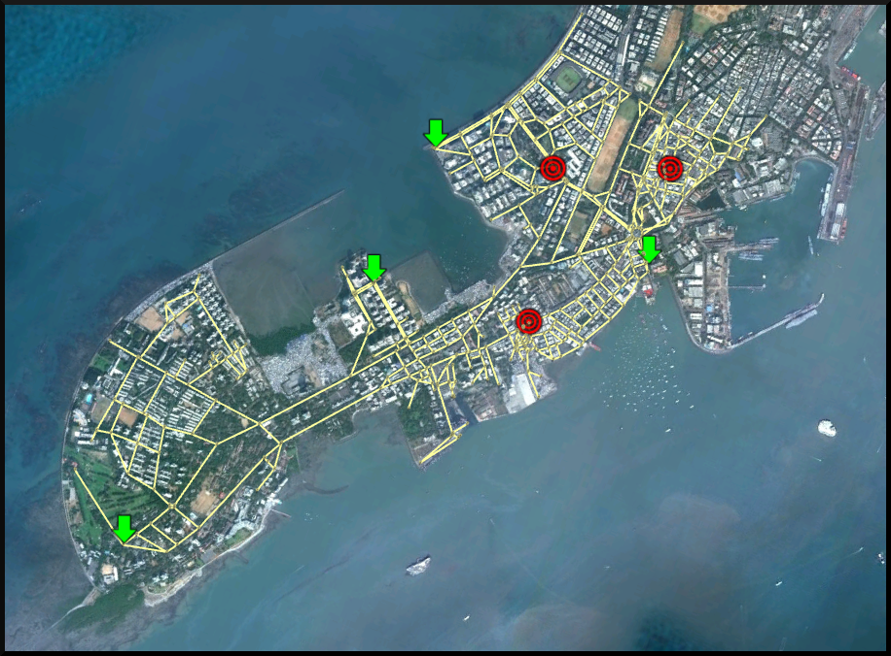
Urban Road Network Security
Southern Mumbai
Notes:
Challenges: exponential # of strategies for defender and attacker

Slide 52

Beyond Counterterrorism: LA Metro
LA Sheriff’s Dept (Crime suppression & ticketless travelers):
Notes:
Challenges: dynamic execution uncertainty
Modeling everyday crime

Slide 53
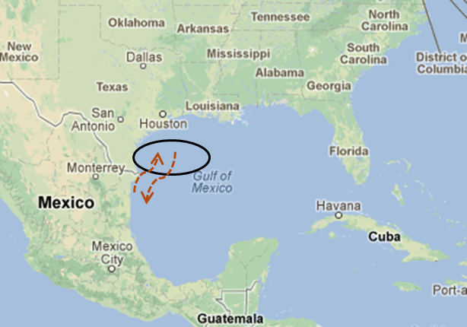
Beyond Counterterrorism: Other Domains
Customs and Border Protection
Cybersecurity
Environmental protection
  Forest
  Fish
Notes:
Mexican vessels poach fish from US EEZ in the Gulf of Mexico
Challenges: uncertainty about fish-rich locations

Slide 54
Research Challenges
Scalable algorithms
  Rich representations; networks
uncertainty, robustness
  Payoff
  Execution
  Imperfect surveillance
Evaluation of deployed systems
Human behavior, bounded rationality
…

Slide 55

Game Solutions
No pure strategies
Target1
Target 2
Target 1
1, -1
-1, 1
Target 2
-1, 1
1, -1
Notes:
Game model: players, targets/strategies, payoffs
Best response (fix defender strategy at 1)
Nash equilibrium
Stackelberg equilibrium

Slide 56
Game Solutions
Mixed Strategy
Target1
Target 2
50%
Target 1
1, -1
-1, 1
50%
Target 2
-1, 1
1, -1
Notes:
Game model: players, targets/strategies, payoffs
Best response (fix defender strategy at 1)
Nash equilibrium
Stackelberg equilibrium

Slide 57
Game Solutions
Nash Equilibrium
A mixed strategy for each
player such that no player benefits
from a unilateral deviation
Target1
Target 2
Target 1
1, -1
-1, 1
Target 2
-1, 1
1, -1
Notes:
Game model: players, targets/strategies, payoffs
Best response (fix defender strategy at 1)
Nash equilibrium
Stackelberg equilibrium

Slide 58
Stackelberg Game: Non-Simultaneous Moves
What is the Nash equilibrium if it were a simultaneous move game?
What if not simultaneous move game:
  Alex [Leader] commits to strategy first
  Bob [Follower] optimize against leader’s fixed strategy
Bob
Nash Equilibrium: <a,c>
 | c | d
a | 2,1 | 4,0
b | 1,0 | 3,2
What if leader (Alex) commits
to “b”
What will be Bob’s response?
Alex

Slide 59
Stackelberg Game: Non-Simultaneous Moves
What if not simultaneous move game:
  Alex [Leader] commits to strategy first
  Bob [Follower] optimize against leader’s fixed strategy
Leader Commitment➔ payoff: 3.5 > 2
Bob
Nash Equilibrium: <a,c>
 | c | d
a | 2,1 | 4,0
b | 1,0 | 3,2
Leader commits to uniform
random strategy {.5,.5}
Follower plays d:
Leader payoff: 3.5 > 2
Alex

Slide 60
Stackelberg Equilibrium
Attackers use
surveillance in
planning attacks
{0.1,0.9}
{0.5,0.5}
Defender
commits to a
mixed strategy
...
...
1
2
1
2
(0, -0.5)
(-0.9, 0.9)
(1.8, -0.9)
(0, 0)
Notes:
Breaking ties in favor of the defender (Strong Stackelberg Equilibrium)
Weak may not exist
Can often induce strong (vonstengel zamir)
More robust concepts: eg quantal response

Slide 61
Strong Stackelberg Equilibrium
Strong Stackelberg Equilibrium (SSE)
  Break ties in favor of the defender
  Can often induce SSE by perturbing defender strategy
  Theorem: Leader utility in SSE >= her utility in the best Nash E
More robust concepts
  Weak Stackelberg Equilibrium not guaranenteed to exist
  Payoff uncertainty
  Quantal response
  Equilibrium refinement

Slide 62
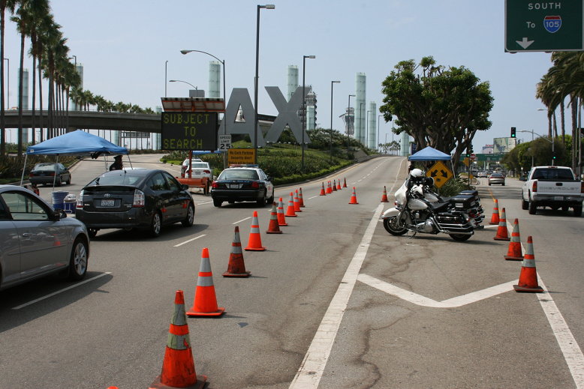
Stackelberg Equilibrium MILP
8 roads
3 checkpoints
8 terminals
56 pure strategies for defender
8 pure strategies for attacker
 | Terminal #1 | Terminal #2 | … | Terminal #8
Road 1,2,3 | 5, -3 | 2, -3 | … | -6, 5
Road 1,2,4 | 5, -3 | 2, -3 | …
…
…
Road 6,7,8 | -5, 5 | -1, 1 | … | 3, -8
…
Checkpoint at LAX
Reward to the defender when he chooses strategy i and attacker j.
Reward to the attacker when he chooses strategy j and defender i.

Slide 63
Obtaining MILP
Requires enumeration of all pure strategies
Defender’s Expected Utility
Defender’s Strategy
Attacker’s Strategy
q is a “best-response” to x
http://u.cs.biu.ac.il/~sarit/data/articles/paruchurietalaamas07.pdf
Paruchuri, Pearce, Tambe, Ordonez, Kraus. An Efficient Heuristic Approach for Security Against Multiple Adversaries. AAMAS 07,

Slide 64
Uncertainty about payoffs: Bayesian Game
P=0.3
P=0.5
P=0.2
 | Term #1 | Term #2
Term#1 | 5, -3 | -1, 1
Term#2 | -5, 5 | 2, -1
 | Term #1 | Term #2
Term#1 | 2, -1 | -3, 4
Term#2 | -3, 1 | 3, -3
 | Term #1 | Term #2
Term#1 | 4, -2 | -1,0.5
Term#2 | -4, 3 | 1.5, -0.5

Slide 65
Obtaining MILP (DOBS)
Decomposing
Substitute

Slide 66

Example Security Game
 | Terminal #1 | Terminal #2 | Terminal #3 | Terminal #4
Terminal #1 | 7, -8 | -5, 8 | -4, 5 | -10, 1
Terminal #2 | -3, 9 | 6, -4 | -4, 5 | -10, 1
Terminal #3 | -3, 9 | -5, 8 | 2, -5 | -10, 1
Terminal #4 | -3, 9 | -5, 8 | -4, 5 | 10, -1
Notes:
Good in some domains, helps in these, but not good enough.
first step
66

Slide 67
Example Security Game: no coverage
Notes:
67

Slide 68
Example Security Game: Uniform Coverage
Notes:
68

Slide 69
DOBSS
[Paruchuri et al., 2008]
  Assumes perfectly rational adversary
  Maximizes expected utility
  Breaks ties in favor of the defender
  Has complete information of the game
Notes:
69

Slide 70
DOBSS
Standard SSE assumption: Attacker plays utility maximizing strategy and breaks ties in favor of the defender
Notes:
70

Slide 71
DOBSS
Standard SSE assumption: Attacker plays utility maximizing strategy and breaks ties in favor of the defender
Attacker chooses t₁ and defender receives 0.60
Notes:
71

Slide 72
DOBSS
Humans may not break ties in the defender’s favor
Attacker chooses t₃ and defender receives -2.70 instead of 0.60
Notes:
72

Slide 73
DOBSS
Notes:
73

Slide 74
DOBSS
Determines an optimal action for the attacker
Notes:
74

Slide 75
DOBSS
Defender gets corresponding reward
Notes:
75

Slide 76
COBRA: Bounded Rationality
Enforce a human perceivable ε-difference
  Set ε = 2.5 and resolve
Pita, Jain, Ordonez, Tambe and Kraus. Robust Solutions to Stackelberg Games: Addressing Bounded Rationality and Limited Observations in Human Preference Models, Artificial Intelligence journal, 2010.
http://u.cs.biu.ac.il/~sarit/data/articles/pitaetal10.pdf
Notes:
76

Slide 77
COBRA: Bounded Rationality
Enforce a human perceivable ε-difference
  Set ε = 2.5 and resolve
Now target t₁ is at least 2.5 units of utility better than t₃ or t₄ for the attacker
ε = 2.5
*Target 4 is a penalty of -10
Notes:
77

Slide 78
COBRA: Bounded Rationality
Enforce a human perceivable ε-difference
  Set ε = 2.5 and resolve
ε = 2.5
If more than 1 target is within ε of the optimal target, maximize the worst case outcome between them
*Target 4 is a penalty of -10
Notes:
78

Slide 79
COBRA: Observational Uncertainty
Perfect observation of the leader strategy
Notes:
79

Slide 80
COBRA: Observational Uncertainty
Perfect observation of the leader strategy
No observation may lead to an anchoring bias on the uniform distribution
Real strategy outcome
Perceived strategy outcome
Notes:
80

Slide 81
COBRA: Observational Uncertainty
Perfect observation of the leader strategy
No observation may lead to an anchoring bias on the uniform distribution
Real strategy outcome
Perceived strategy outcome
Attacker plays t₂ to maximize expected outcome and defender receives -0.3 instead of 0.6
Notes:
81

Slide 82
COBRA: Observational Uncertainty
Solution: Optimize against the attacker’s belief:
  α decreases with the number of observations
For example: In situations involving no observation
Perceived strategy outcome
(No observation)
Real strategy outcome
Notes:
82

Slide 83
COBRA: Observational Uncertainty
Solution: Optimize against the attacker’s belief:
  α decreases with the number of observations
Perceived strategy outcome
(No observation)
Real strategy outcome
Attacker plays t₂ to maximize expected outcome and defender receives 6 instead of -0.3 (from standard optimal strategy)
Notes:
83

Slide 84
COBRA
Notes:
84

Slide 85
COBRA
Determine ε-optimal actions
Notes:
85

Slide 86
COBRA
Attacker’s beliefs based on their anchoring bias
Notes:
86

Slide 87
COBRA
New method for calculating defender’s expected utility
Notes:
87

Slide 88
DOBSS
Previously defender received the corresponding reward to the attacker’s optimal action
Notes:
88

Slide 89
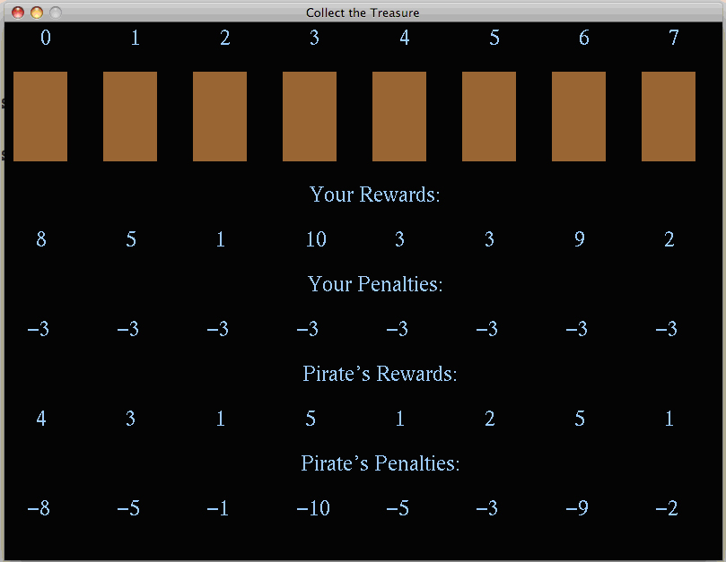
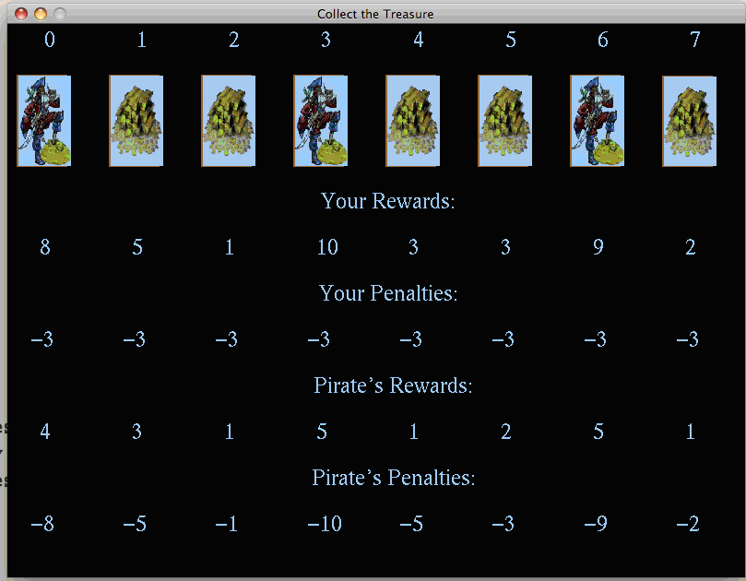
Experiment Interface
Notes:
89

Slide 90

Experimental Results
178 total subjects
2480 total trials played
40 different subjects for each game setting

Slide 91
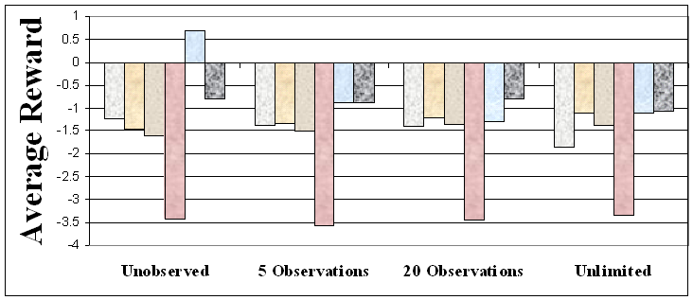
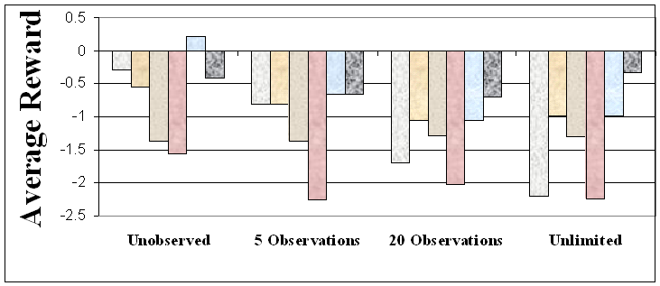
Results – Reward Structures 1 & 2
Notes:
C- fixed alpha
91

Slide 92
Robust Algorithms
MATCH
  Assume adversary maximizes expected utility
  Extends robust optimization idea of COBRA’s ε-deviation
  Robustly constrain the defender’s loss for ANY deviation
  Designed for near perfect observation conditions
Notes:
92

Slide 93
Quantal Response
Quantal Response (QR)
  Stochastic distribution of adversary response
Key idea
  Higher expected value – higher probability of attack
  Parameter : measure rationality of adversary
Probability of attacking target t
Nguyen, Yang, Azaria, Kraus and Tambe Analyzing the Effectiveness of Adversary Modeling in Security Games, AAAI 2013.
http://u.cs.biu.ac.il/~sarit/data/articles/aaai2013_suqr.pdf
Notes:
Given the representation of SSGs as I described, I’m going to present in details about our new SUQR model in the next part. But first , let me briefly describe the classic Quantal Response model. In general, Quantal Response tries to predict a stochastic distribution of the adversary’s response. In particular, the probability that the adversary will attack target t can be represented as the formula in the slide. In short, the higher the expected value of a target, the more likely that the adversary will attack that target. The parameter lambda is the key value which measures how rationality the adversary is.

Slide 94
SUQR
SSG representation Full Information
  Defender payoff:
  Adversary payoff:
  Coverage probability:
  Defender expected value (EU):
Subjective utility function
SUQR
  Key parameters:
Notes:
As I mentioned earlier that in recent works, they shows that the robust algorithm MATCH significantly outperforms the BRQR algorithm which is based on Quantal Response. Given this result, our hypothesis is that the Quantal Response integrated with the expected value function does not well capture the human adversaries’ behavior in security games.
Therefore, we propose a new subjective utility function which is a linear combination of 3 key criteria: the defender’s coverage probability , the adversary’s reward and penalty at each target. The intuition behind this function is these 3 criteria are the most important factors for the adversary to consider at each decision-making process. Also, the idea of using a linear function is motivated by previous studies showing the power of this simple method in predicting the human decision-making. As I am going to show you later, this subjective utility function does significantly improve the performance of our algorithm over MATCH. In other words, this simple linear function helps predicting the human adversary’s response in security games much more accurately than the expected value function.
Our new SUQR model is a novel integration of Quantal Response with the subjective utility function. Specifically, the utility of the adversary is measured using the SU function instead of the expected value. As the result, the distribution of the adversary’s response can be predicted using the formula shown in the slide. As you can see, in our new SUQR, there are 4 unknown key parameters that we need to estimate: the key parameter lambda of the QR and the 3 parameters of the SU function. I’m going to show you later how to estimate these parameters.

Slide 95
SUQR - Learning Parameters
Learning SUQR parameters:
  Apply Maximum Likelihood Estimation (MLE)
  W.l.o.g.; = 1
We collected examples of people choices and used MLE to determine the parameters that will be “closer” to the actual choice.
Notes:
In order to learn the parameters of the SUQR, we used the MLE which is a popular and efficient method for learning parametric models. Specifically, given that there are N sample choices and N_t choices of target t, the log-likelihood function can be formulated as shown in the slide. Although this function looks a little bit complicated, it comes out that the log-likelihood function is concave which means that there exists only one local maximal point. Therefore, we can use any convex solver such as the fmincon of Matlab to estimate the parameters.

Slide 96
Experimental Setup
Sets of experiments
  AMT workers, 8-target games, 3 resources
  Security intelligence experts, 8-target games, 3 resources
  AMT workers, 24-target games, 9 resources
Experimental settings:
  Main tested algorithms: SU-BRQR, MATCH
  Other tested algorithms: DOBSS, improved versions of MATCH
  22 selected payoff structures: based on covariance games in GAMUT (Nudelman et al. 2004)
  Human subjects: At least 40 participants each game
Statistical test:
  t-bootstrap method (alpha = .05)
Notes:
We conducted 3 sets of experiments: The first one is based on 8 target games and 3 defender resources with AMT workers. This set of experiment is motivated by previous works. The second experiments is based on 8 target games with a completely new type of human subjects: the security intelligence experts. Finally, our third experiment is conducted in a new large game setting with 24 target games and 9 resources.
There are 2 main tested algorithms: our new SU-BRQR algorithm and MATCH. There are also other tested algorithms in our experiments that are not presented in this presentation. You can refer to our paper to get more results of our experiments. To compare the performance of tested algorithms, we systematically selected 22 payoff structures which is based on covariance games. There are at least 40 human subjects playing each game. In addition, t-bootstrap method is used to test the statistical significance of our experimental results

Slide 97
Experiments Results
Adversary modeling is important in solving SSGs
  SU-BRQR significantly outperforms MATCH
SU-BRQR performs efficiently in new game scenarios
  Security intelligence experts
  New large game settings of 24-target games, 9 defender resources
Notes:
All the experimental results that I have presented directly and strongly answer the question that I posted from the beginning, that is, adversary modeling is very important in solving SSGs. Also, our new SU-BRQR not only significantly outperforms MATCH but also shows potential performance in new game scenario without any knowledge about these circumstances such as with security intelligence experts or with new large game settings of 24 targets and 9 defender resources

Slide 98
How Could Deployed Systems be Evaluate?
Evaluating deployed systems not easy
  Cannot switch security on/off for controlled experiments
  Cannot show we are “safe” (no 100% security)
Are our systems useful: Are we better off than previous approaches?
  Models and simulations
  Human adversaries in the lab
  Actual security schedules before vs after
  Expert evaluation
  “Adversary” teams simulate attack
  Supportive data from deployment
  Future deployments

Slide 99

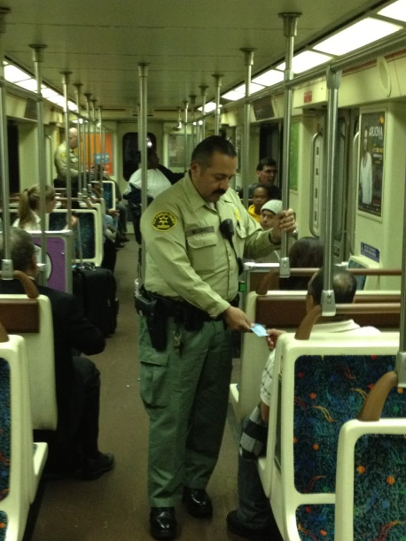

Fare Evasion: Mixed Strategy Evaluation
Mixed strategy computed using Game Theory (GT) vs Mixed Strategy computed using Uniform Random (UR)
  UR: automated tool used to allocate security resources
  Idea: race between algorithms
    which strategy leads to more captures?
Delle, Yin, Zhang, Tambe, Kraus, Sullivan. Game-theoretic Security Patrolling with
Dynamic Execution Uncertainty and a Case Study on a Real Transit System, JAIR 2014
http://teamcore.usc.edu/papers/2014/jair2014-execution.pdf

Slide 100
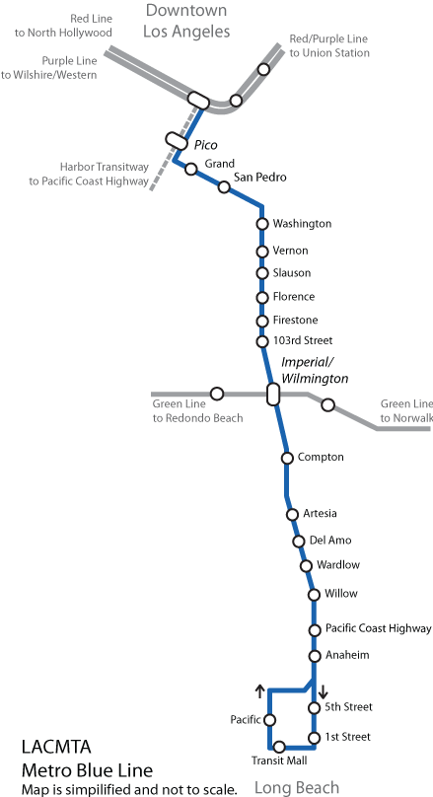
Fare Evasion Trials on the LA Metro
Setup:
  Blue Line (22 stations)
  Duration: 21 week-days
  Patrol time: 0 to 120 minutes
  1 team of 2 security assistants
  Time of day: off peak - morning and early afternoon
  Performance measure:
    # of captures / 30 minutes
      = (# warnings + # arrests + # citations) / 30 minutes

Slide 101
Results: In general, GT performed better than UR
 | # Days | # Captures /30min
GT | 11 | 15.52
UR | 10 | 9.55
GT produced a larger number of captures.
Statistical tests confirmed the significance of this result.

Slide 102
Results: GT performed better despite UR augmented with human intelligence
 | # Days | # Captures /30min
GT | 11 | 15.52
UR | 10 | 9.55
 | # Voluntary Deviations
GT | 0
UR | 8
The officers could request a new schedule if they did not like the current one
  Never deviated using GT
  They deviated 8 times using UR schedules

Slide 103
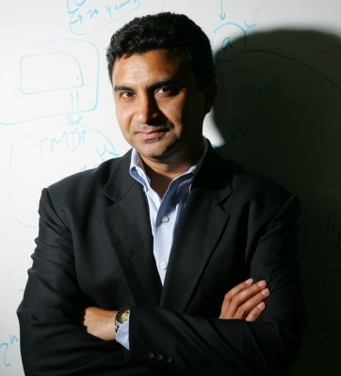
Dynamic Modeling
Dynamic modeling of the changing environment.
Continuously learning of the adversary
Milind Tambe

