Slide 1


Intelligent Systems for Homeland Security
Sarit Kraus
Dept of Computer Science
Bar-Ilan University
Israel
sarit@cs.biu.ac.il
http://www.cs.biu.ac.il/~sarit/

Slide 2
Learning from Observations
Inductive Learning - learning from examples
  Machine Learning

Slide 3
What Is Machine Learning?
Environment
same
time
Environment
System
System
Action₁
Action₂
Knowledge
Knowledge
changed

Slide 4
Ways humans learn things
…talking, walking, running…
Learning by mimicking, reading or being told facts
Tutoring
Being informed when one is correct
Experience
Feedback from the environment
Analogy
Comparing certain features of existing knowledge to new problems
Self-reflection
Thinking things in ones own mind, deduction, discovery

Slide 5

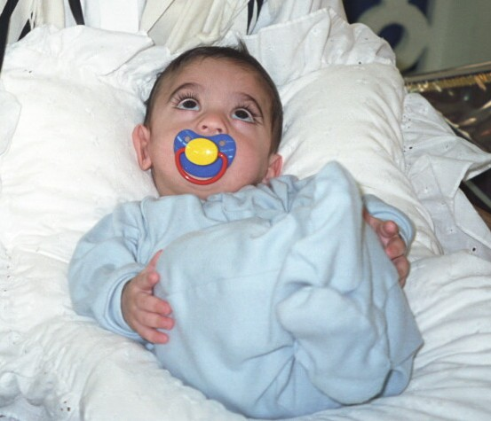
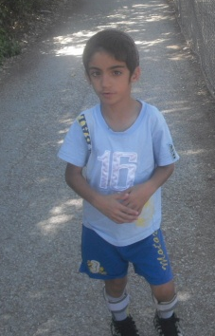




Slide 6
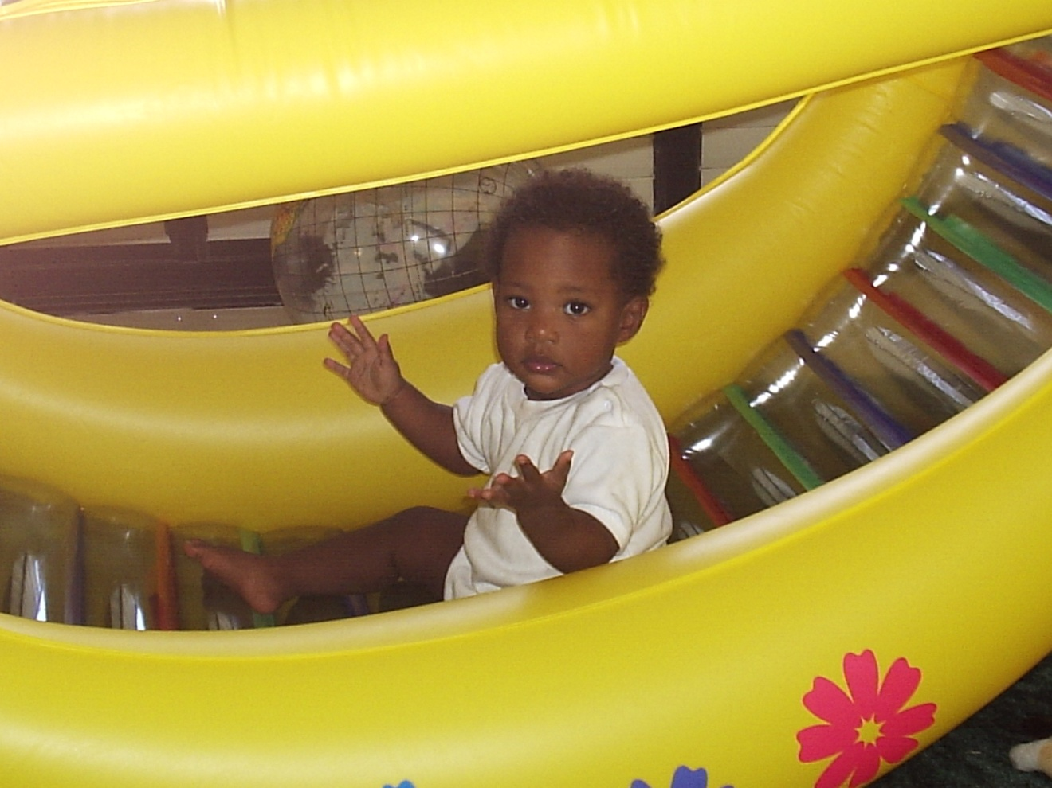
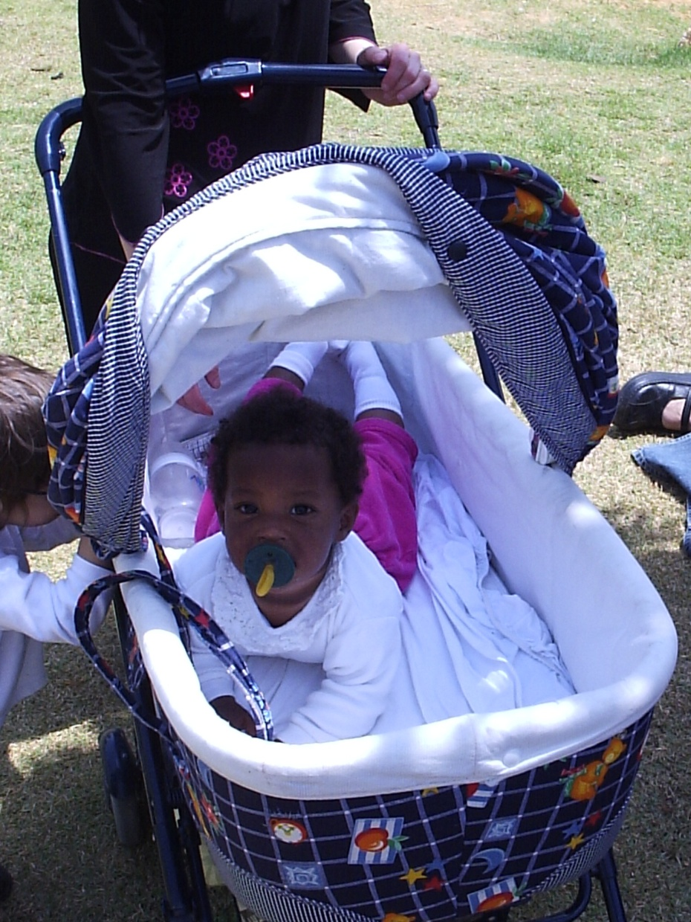

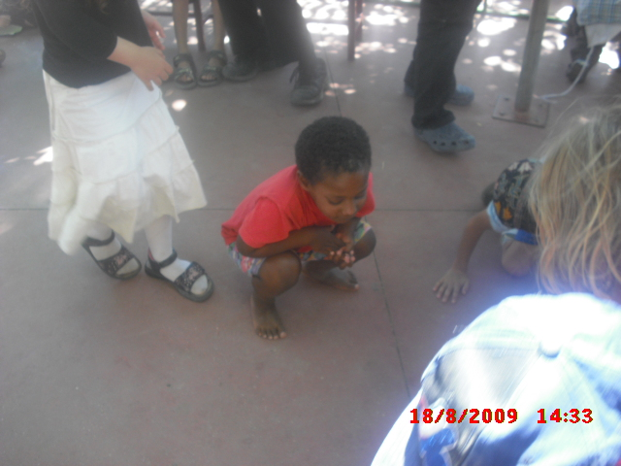

Slide 7
A few achievements
Programs that can:
  Recognize spoken words
  Predict recovery rates of pneumonia patients
  Detect fraudulent use of credit cards
  Drive autonomous vehicles
  Play games like backgammon; Jeopardy; – approaching the human champion!

Slide 8
Classification Problems
Given input:
Predict the output (class label)
  Binary classification:
  Multi-class classification:
Learn a classification function:

Slide 9
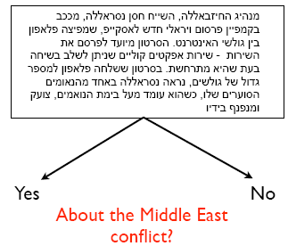
Text Classification
Text Classification Example
Yes No
About the Middle East
conflict?
Text
Assign items to one of a set of predefined classes of objects based on a set of observed features
Text

Slide 10
Classification
Text Classification Example
Yes No
About the Middle East
conflict?
Text
Assign items to one of a set of predefined classes of objects based on a set of observed features

Slide 11
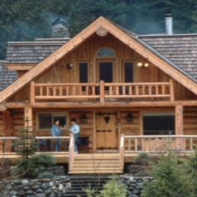
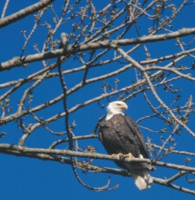
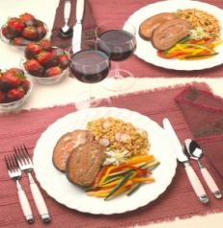
Examples of Classification Problem
Image Classification:
Input features X
  Color histogram
  {(red, 1004), (red, 23000), …}
Class label y
  Y = +1: ‘bird image’
  Y = -1: ‘non-bird image’
Which images have birds, which one does not?

Slide 12
Examples of Classification Problem
Image Classification:
Input features
  Color histogram
  {(red, 1004), (blue, 23000), …}
Class label
  ‘bird image’:
  ‘non-bird image’:
Which images are birds, which are not?

Slide 13
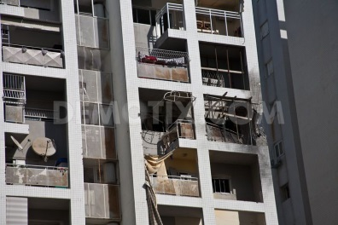
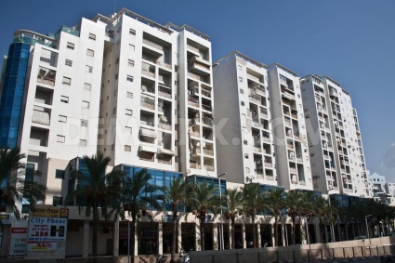

Examples of Classification Problems
Image Classification:
Input features
Class label
  ‘live’:
  ‘don’t live image’:
Do people live in the house?

Slide 14
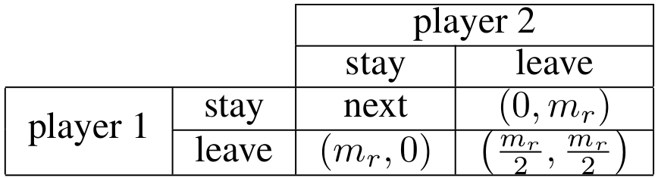

Examples of Classification Problems
Centipede Game
  After each round the money is being duplicated
  Players have an incentive to hide their intention.
Video classifications
What is she going to do? Stay or Leave

Slide 15
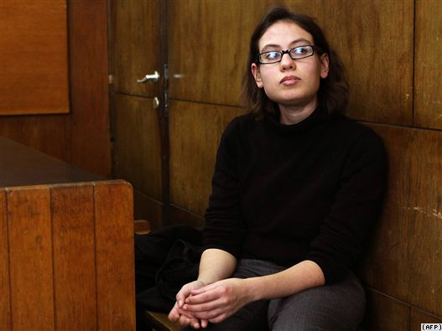


Insider Threats
Examples of Classification Problems
Threat posed to organizations by individuals who have legitimate rights to access the internal system (Fraud, theft, sabotage)
Detecting malicious insiders - huge challenge
  Very limited amounts of real data available
  Small number of insiders (imbalanced data)
  Training data that is available is flawed

Slide 16
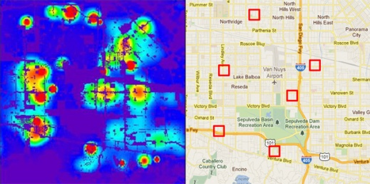
Examples of Classification Problems
Is a given area a crime zone?

Slide 17
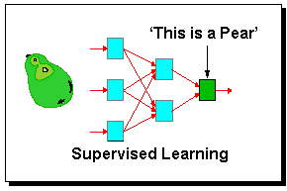
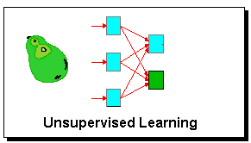
Learning Paradigms
Supervised learning - with teacher
    inputs and correct outputs are provided by the teacher
Reinforced learning - with reward or punishment
    an action is evaluated
Unsupervised learning - with no teacher
    no hint about correct output is given

Slide 18
Supervised Learning
Training examples:
Identical independent distribution (i.i.d) assumption
  A critical assumption for machine learning theory

Slide 19
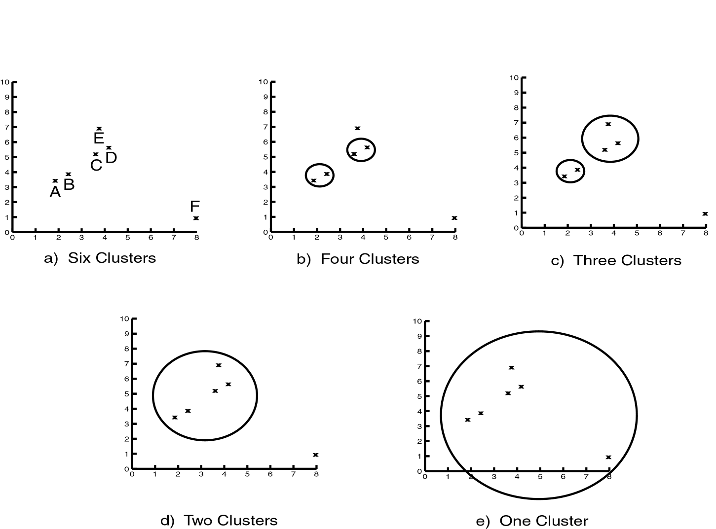
Unsupervised learning:
Clustering
Seeks to place objects into meaningful groups automatically, based on their similarity. Does not require the groups to be predefined. The hope in applying clustering algorithms is that they will discover useful but unknown classes of items.
Insider Threats
Talkbacks

Slide 20
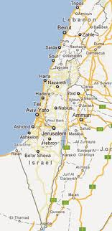

Reinforcement Learning
Need to take actions to collect examples.
Typically formulated as a Markov Decision Process (MDP).
Exploration vs Exploitation

Slide 21
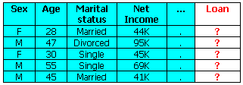
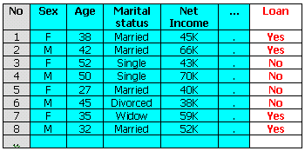
Supervised Learning Example
New data
Train set
Test set
Model
Loan
Yes/No
Learning system

Slide 22
Evaluation: Cross Validation
Divide training examples into two sets. A training set (80%) and a validation set (20%)
  Predict the class labels for validation set by using the examples in training set
10-cross validation – choose 90% as training; 10% as testing; do 10 times; return average accuracy.
Leave-one-out – train on all examples, but one; test on the one left out. Average on all examples.

Slide 23

Machine Learning Methods
Instance Based Methods (CBR, k-NN)
Decision Trees
Artificial Neural Networks
Bayesian Networks
Naïve Base
Evolutionary Strategies
Support Vector Machines
..

Slide 24
Nearest Neighbor
Simple effective approach for supervised learning problems
Envision each example as a point in n-dimensional space
Classify test point same as nearest training point (Euclidean distance)

Slide 25
k-Nearest Neighbor
Nearest Neighbor can be subject to noise
  Incorrectly classified training points
  Training anomalies
k-Nearest Neighbor
  Find k nearest training points (k odd) and vote on which classification
Works on numerical data

Slide 26
Decision Trees
Decision tree representation
ID3 learning algorithm
Entropy, information gain
Overfitting

Slide 27
Introduction
Use a decision tree to predict categories for new events.
Use training data to build the decision tree.
New
Events
Training
Events and
Categories
Decision
Tree
Category

Slide 28
Decision Tree for PlayTennis
Outlook
Sunny
Overcast
Rain
Humidity
Each internal node tests an attribute
High
Normal
Each branch corresponds to an
attribute value node
No
Yes
Each leaf node assigns a classification

Slide 29
Decision Tree for Conjunction
Outlook=Sunny ∧ Wind=Weak
Outlook
Sunny
Overcast
Rain
Wind
No
No
Strong
Weak
No
Yes

Slide 30
Decision Tree for Disjunction
Outlook=Sunny ∨ Wind=Weak
Outlook
Sunny
Overcast
Rain
Yes
Wind
Wind
Strong
Weak
Strong
Weak
No
Yes
No
Yes

Slide 31
Decision Tree for XOR
Outlook=Sunny XOR Wind=Weak
Outlook
Sunny
Overcast
Rain
Wind
Wind
Wind
Strong
Weak
Strong
Weak
Strong
Weak
Yes
No
No
Yes
No
Yes

Slide 32
Decision Tree
decision trees represent disjunctions of conjunctions
Outlook
Sunny
Overcast
Rain
Humidity
Yes
Wind
High
Normal
Strong
Weak
No
Yes
No
Yes
(Outlook=Sunny ∧ Humidity=Normal)
∨ (Outlook=Overcast)
∨ (Outlook=Rain ∧ Wind=Weak)

Slide 33
When to consider Decision Trees
Instances describable by attribute-value pairs
Target function is discrete valued
Disjunctive hypothesis may be required
Possibly noisy training data
Missing attribute values
Examples:
  Medical diagnosis
  Credit risk analysis
  Object classification for robot manipulator (Tan 1993)

Slide 34
Top-Down Induction of Decision Trees ID3
A ← the “best” decision attribute for next node
Assign A as decision attribute for node
For each value of A create new descendant
Sort training examples to leaf node according to
the attribute value of the branch
If all training examples are perfectly classified (same value of target attribute) stop, else iterate over new leaf nodes.

Slide 35
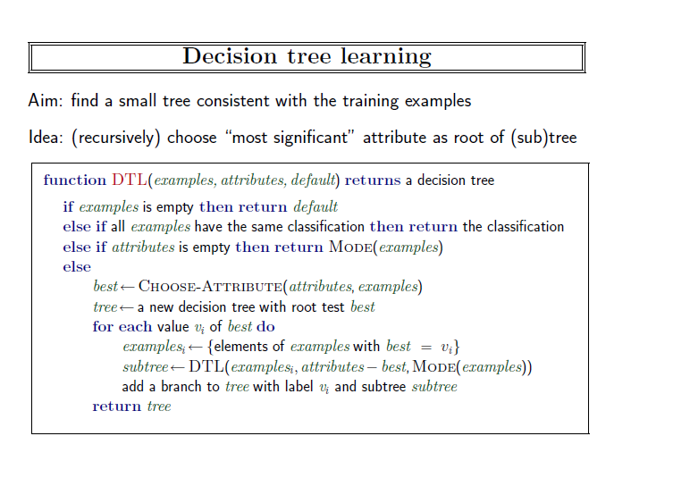

Slide 36
Which attribute is best?
[29+,35-]
A₁=?
A₂=?
[29+,35-]
G
H
L
M
[21+, 5-]
[8+, 30-]
[18+, 33-]
[11+, 2-]

Slide 37
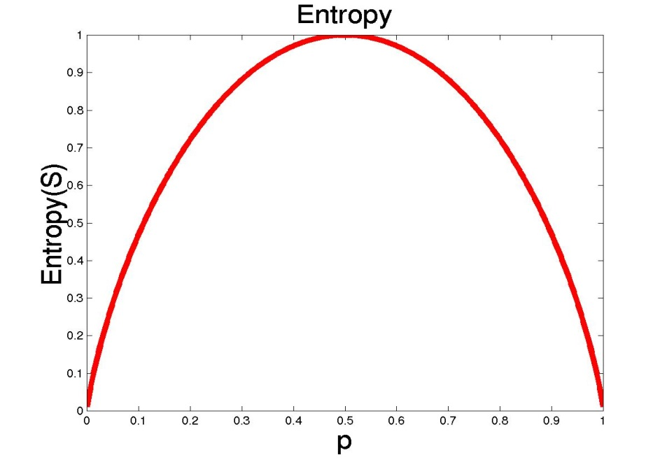
Entropy
S is a sample of training examples
p₊ is the proportion of positive examples
p₋ is the proportion of negative examples
Entropy measures the impurity of S
  Entropy(S) = -p₊ log₂ p₊ - p₋ log₂ p₋

Slide 38
Entropy
Entropy(S)= expected number of bits needed to encode class (+ or -) of randomly drawn members of S (under the optimal, shortest length-code)
Why?
Information theory optimal length code assign
–log₂ p bits to messages having probability p.
So the expected number of bits to encode
(+ or -) of random member of S:
  -p₊ log₂ p₊ - p₋ log₂ p₋

Slide 39

Information Gain (S=E)
Gain(S,A): expected reduction in entropy due to sorting S on attribute A
Entropy([29+,35-]) = -29/64 log2 29/64 – 35/64 log2 35/64
= 0.99
[29+,35-]
A₁=?
A₂=?
[29+,35-]
G
H
True
False
[21+, 5-]
[8+, 30-]
[18+, 33-]
[11+, 2-]

Slide 40
Information Gain
Entropy([18+,33-]) = 0.94
Entropy([11+,2-]) = 0.62
Gain(S,A2)=Entropy(S)
-51/64*Entropy([18+,33-])
-13/64*Entropy([11+,2-])
=0.12
Entropy([21+,5-]) = 0.71
Entropy([8+,30-]) = 0.74
Gain(S,A₁)=Entropy(S)
-26/64*Entropy([21+,5-])
-38/64*Entropy([8+,30-])
=0.27
[29+,35-]
A₁=?
A₂=?
[29+,35-]
True
False
True
False
[21+, 5-]
[8+, 30-]
[18+, 33-]
[11+, 2-]

Slide 41
Training Examples
Day
Outlook
Temp.
Humidity
Wind
Play Tennis
D1
Sunny
Hot
High
Weak
No
D2
Sunny
Hot
High
Strong
No
D3
Overcast
Hot
High
Weak
Yes
D4
Rain
Mild
High
Weak
Yes
D5
Rain
Cool
Normal
Weak
Yes
D6
Rain
Cool
Normal
Strong
No
D7
Overcast
Cool
Normal
Weak
Yes
D8
Sunny
Mild
High
Weak
No
D9
Sunny
Cold
Normal
Weak
Yes
D10
Rain
Mild
Normal
Strong
Yes
D11
Sunny
Mild
Normal
Strong
Yes
D12
Overcast
Mild
High
Strong
Yes
D13
Overcast
Hot
Normal
Weak
Yes
D14
Rain
Mild
High
Strong
No

Slide 42
Selecting the Next Attribute
S=[9+,5-]
E=0.940
S=[9+,5-]
E=0.940
Humidity
Wind
High
Normal
Weak
Strong
[3+, 4-]
[6+, 1-]
[6+, 2-]
[3+, 3-]
E=0.592
E=0.811
E=0.985
E=1.0
Gain(S,Humidity)
=0.940-(7/14)*0.985
– (7/14)*0.592
=0.151
Gain(S,Wind)
=0.940-(8/14)*0.811
– (6/14)*1.0
=0.048
Humidity provides greater info. gain than Wind, w.r.t target classification.

Slide 43
Selecting the Next Attribute
S=[9+,5-]
E=0.940
Outlook
Over
cast
Sunny
Rain
[2+, 3-]
[4+, 0]
[3+, 2-]
E=0.971
E=0.0
E=0.971
Gain(S,Outlook)
=0.940-(5/14)*0.971
-(4/14)*0.0 – (5/14)*0.0971
=0.247

Slide 44
Selecting the Next Attribute
The information gain values for the 4 attributes are:
Gain(S,Outlook) =0.247
Gain(S,Humidity) =0.151
Gain(S,Wind) =0.048
Gain(S,Temperature) =0.029
where S denotes the collection of training examples

Slide 45
ID3 Algorithm
[D1,D2,…,D14]
[9+,5-]
Outlook
Sunny
Overcast
Rain
S_{sunny} =[D1,D2,D8,D9,D11]
[2+,3-]
[D3,D7,D12,D13]
[4+,0-]
[D4,D5,D6,D10,D14]
[3+,2-]
?
Yes
?
Gain(S_{sunny}, Humidity)=0.970-(3/5)0.0 – 2/5(0.0) = 0.970
Gain(S_{sunny}, Temp.)=0.970-(2/5)0.0 –2/5(1.0)-(1/5)0.0 = 0.570
Gain(S_{sunny}, Wind)=0.970= -(2/5)1.0 – 3/5(0.918) = 0.019

Slide 46
ID3 Algorithm
Outlook
Sunny
Overcast
Rain
Humidity
Yes
Wind
[D3,D7,D12,D13]
High
Normal
Strong
Weak
No
Yes
No
Yes
[D1,D2]
[D8,D9,D11] [mistake]
[D6,D14]
[D4,D5,D10]

Slide 47
Curse of Dimensionality
Imagine instances described by 20 attributes, but only 2 are relevant to target function
Curse of dimensionality: machine learning algorithms are easily mislead when high dimensional X

Slide 48
Occam’s Razor
”If two theories explain the facts equally weel, then the simpler theory is to be preferred”
Arguments in favor:
  Fewer short hypotheses than long hypotheses
  A short hypothesis that fits the data is unlikely to be a coincidence
  A long hypothesis that fits the data might be a coincidence
Arguments opposed:
  There are many ways to define small sets of hypotheses

Slide 49
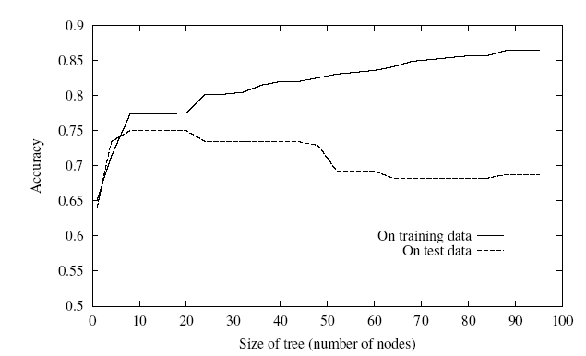
Overfitting
One of the biggest problems with decision trees is Overfitting

Slide 50
Avoid Overfitting
stop growing when split not statistically significant
grow full tree, then post-prune
Select “best” tree:
measure performance over training data
measure performance over separate validation data set
min( |tree|+|misclassifications(tree)|)

Slide 51
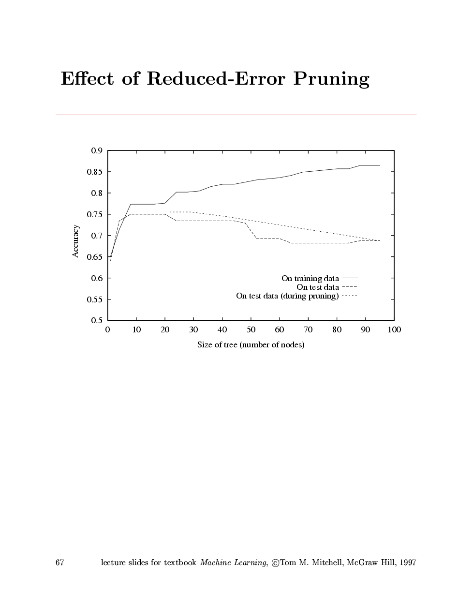
Effect of Reduced Error Pruning

Slide 52
Converting a Tree to Rules
Outlook
Sunny
Overcast
Rain
Humidity
Yes
Wind
High
Normal
Strong
Weak
No
Yes
No
Yes
R₁: If (Outlook=Sunny) ∧ (Humidity=High) Then PlayTennis=No
R₂: If (Outlook=Sunny) ∧ (Humidity=Normal) Then PlayTennis=Yes
R₃: If (Outlook=Overcast) Then PlayTennis=Yes
R₄: If (Outlook=Rain) ∧ (Wind=Strong) Then PlayTennis=No
R₅: If (Outlook=Rain) ∧ (Wind=Weak) Then PlayTennis=Yes

Slide 53
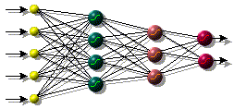
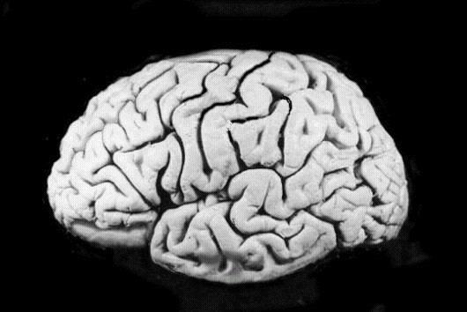
Artificial Neural Networks

Slide 54
An Artificial Neuron
y₁
w_{1j}
y₂
w_{2j}
w_{3j}
f(x)
O
y₃
y_{i}
w_{ij}
Each hidden or output neuron has weighted input connections from each of the units in the preceding layer.
The unit performs a weighted sum of its inputs, and subtracts its threshold value, to give its activation level.
Activation level is passed through a sigmoid activation function to determine output.

Slide 55
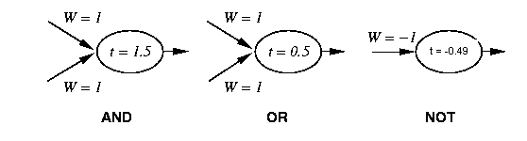
Perceptron Training
1 if Σ w_{i} x_{i} >t
Output=
0 otherwise
{
_{i=0}
Linear threshold is used.
W - weight value
t - threshold value

Slide 56
Learning algorithm
While epoch produces an error
  Present network with next inputs from epoch
  Error = T – O
  If Error <> 0 then
    W_{j} = W_{j} + LR * I_{j} * Error
  End If
End While

Slide 57
Learning algorithm
Epoch : Presentation of the entire training set to the neural network.
In the case of the AND function an epoch consists of four sets of inputs being presented to the network (i.e. [0,0], [0,1], [1,0], [1,1])
Error: The error value is the amount by which the value output by the network differs from the target value. For example, if we required the network to output 0 and it output a 1, then Error = -1

Slide 58
Learning algorithm
Target Value, T : When we are training a network we not only present it with the input but also with a value that we require the network to produce. For example, if we present the network with [1,1] for the AND function the target value will be 1
Output , O : The output value from the neuron
Ij : Inputs being presented to the neuron
Wj : Weight from input neuron (I_{j}) to the output neuron
LR : The learning rate. This dictates how quickly the network converges. It is set by a matter of experimentation. It is typically 0.1

Slide 59
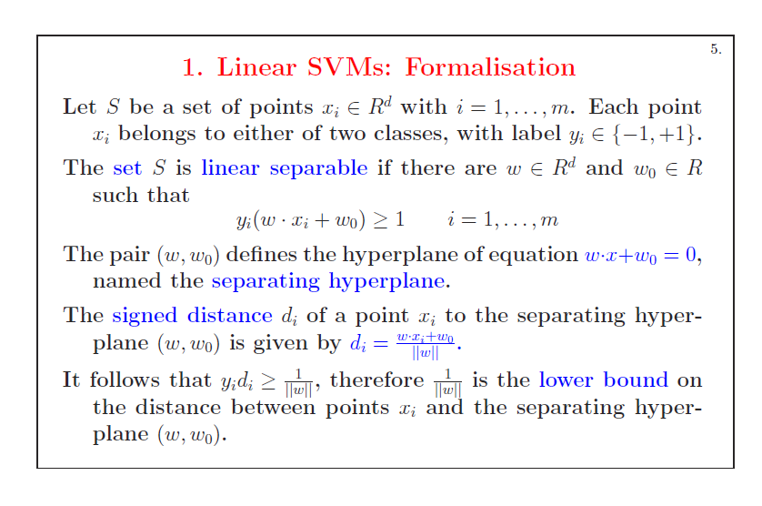

Slide 60
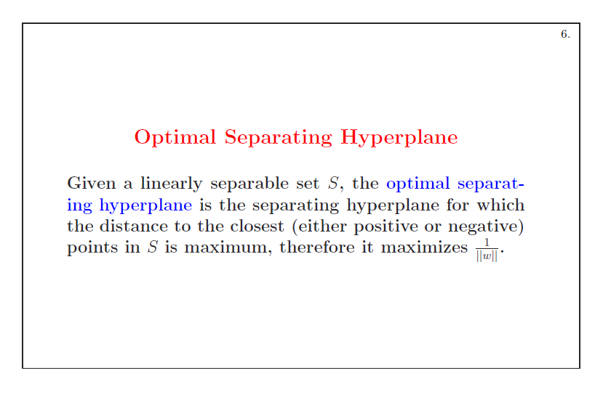

Slide 61
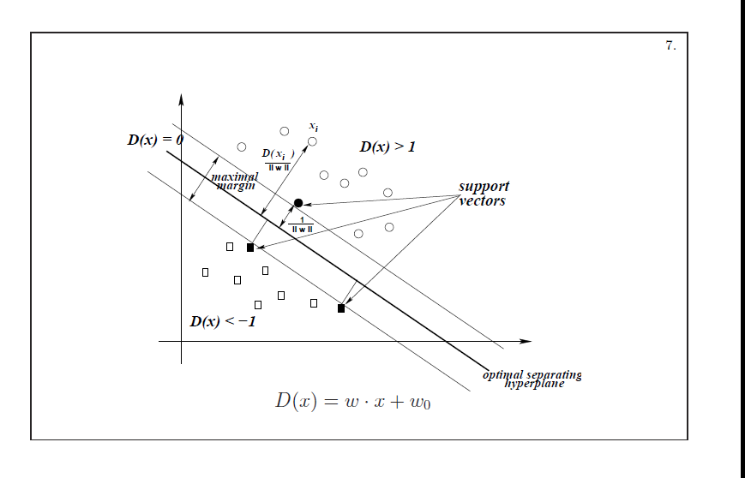

Slide 62
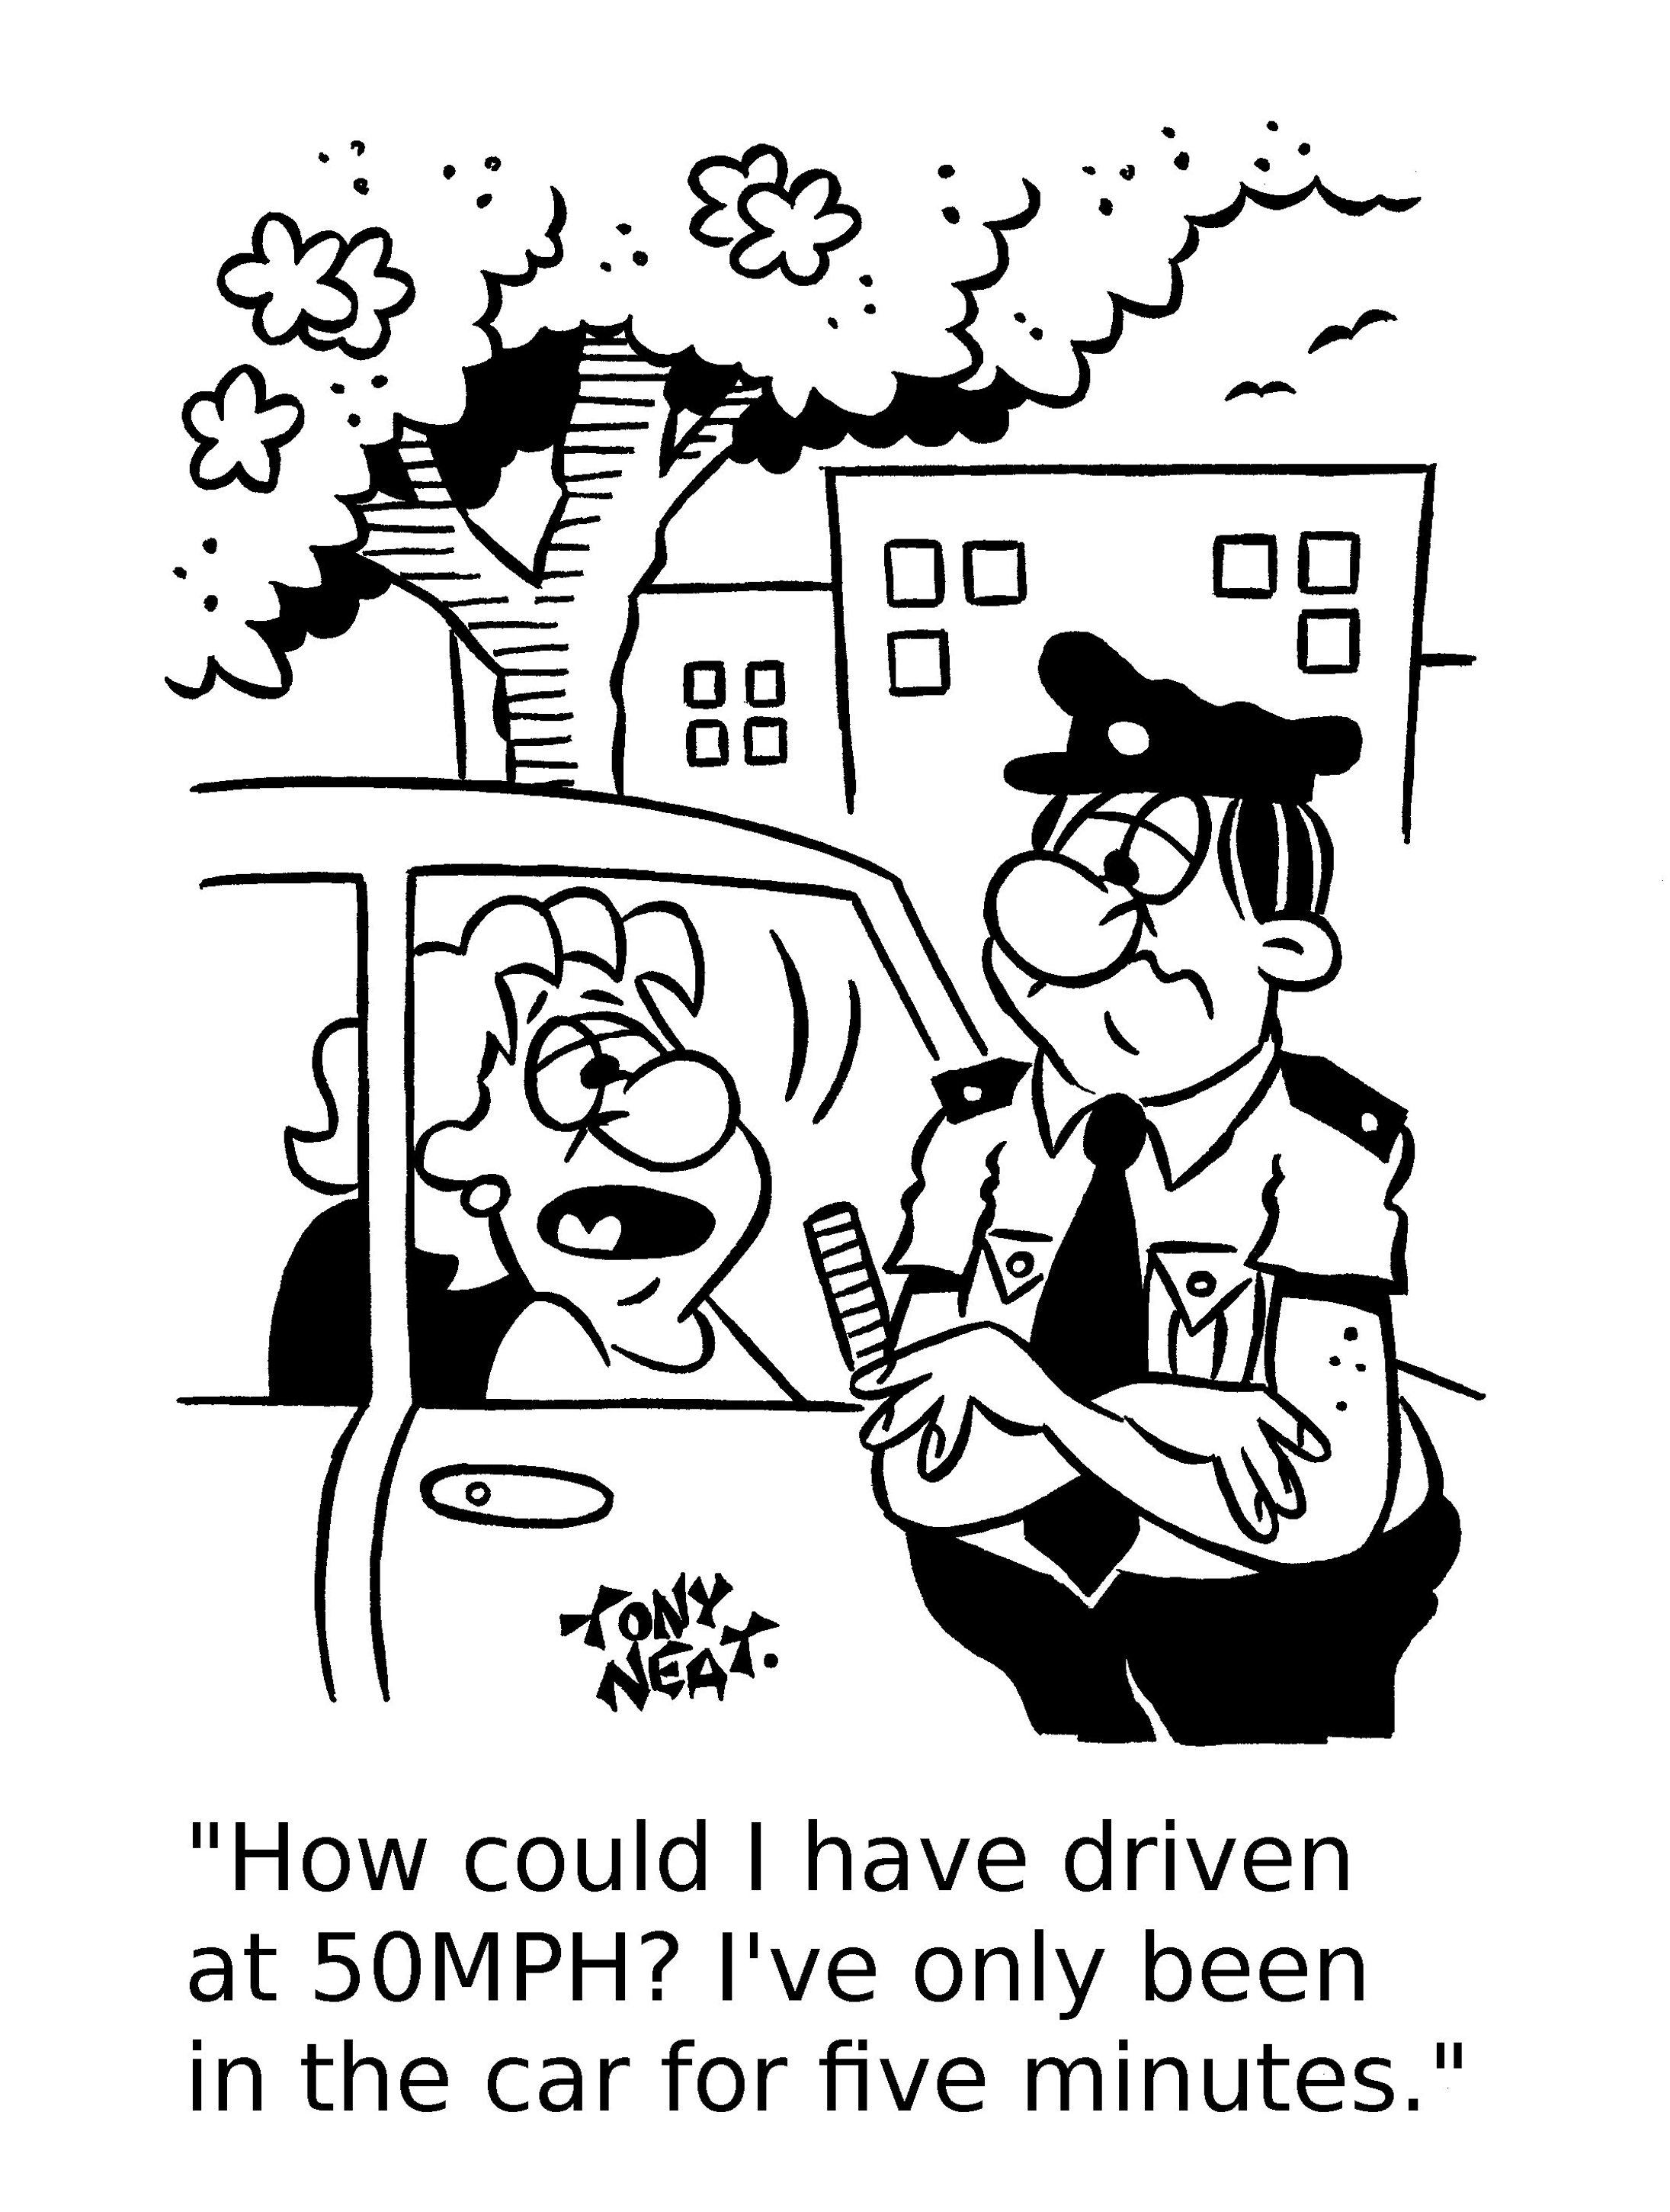
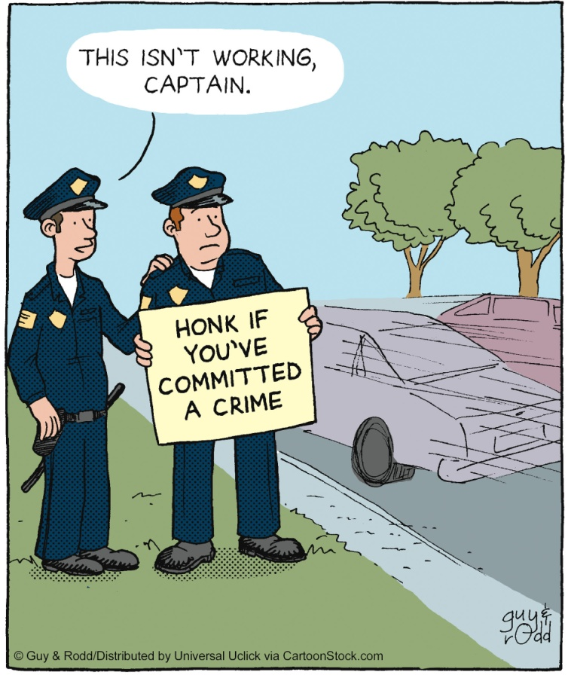

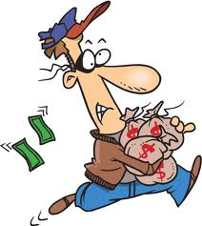

Using ML for Deception, Fraud and Cheating identifications
  From Psychology (Ekman):
  It is not a simple matter to catch lies.
  People give away lies through body language and tone.
Automatic detection of lies
  Using video / audio / text data.
In our work we focus on discussion based environments.
Notes:
Unfortunately, our world is full with deception. From a 65 billion fraud (Madoff). Small lies by drivers who exceed the speed limit “I wasn’t speeding…”, “I’m losing on you…”. How can we catch a liar?

Slide 63
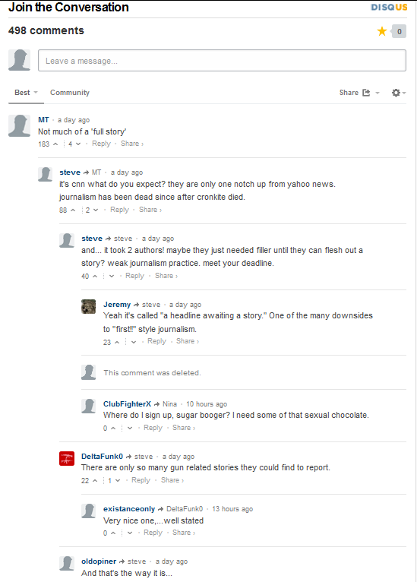

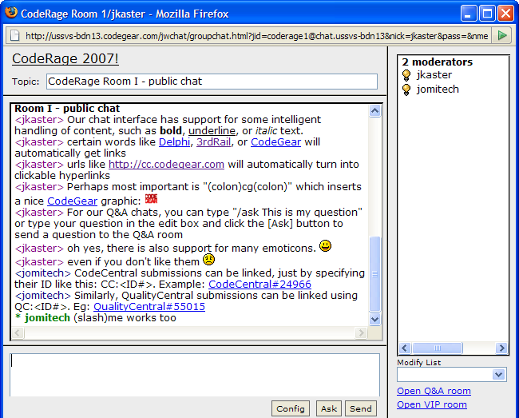
Text Deception in Discussion Based Environments

Slide 64
Why an Agent?
The agent may be implanted as an ordinary player when one can’t control the system.
Since agents interacting with humans become more and more popular, future agents will also need to deal with deception.
Agents goals (in discussion based environments):
  Detect deceiver.
  Convince others on his presence.
  Avoid raising suspicion itself.
Azaria, Richardson, Kraus S,
Autonomous Agent for Deception Detection, HAIDM (In AAMAS) 2013

Slide 65


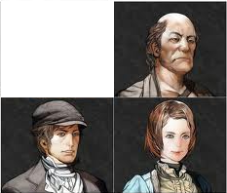



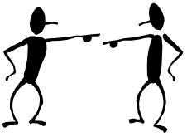



The Pirate Game - Story

Slide 66
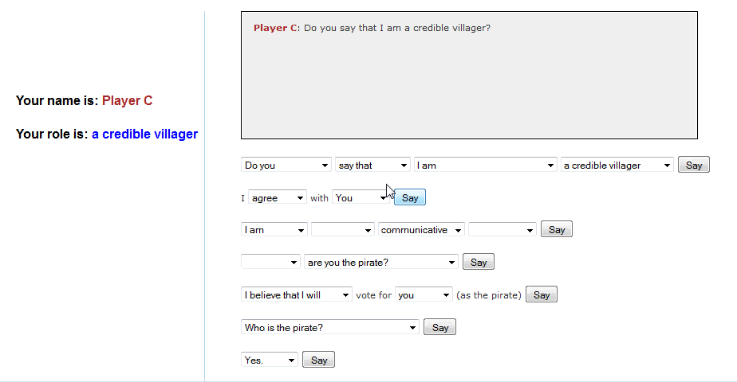
Experimental Environment
pirate4.avi
http://cupkey.com/home/pgTrain

Slide 67
Structured Sentences
Focus on the dynamics of the discussion, and less on the syntax.
Encourage meaningful sentences.
No need for complex NLP components.
Eliminates typing speed disparity issues.
Allows us to deploy an agent.
Note: the pirate may not vote.

Slide 68
Machine Learning Methodology
SVM
41 features:
  Fraction of talking
  Accusations
  Consistency
  First Sentence
  First accusation
  Self-justification
  Alter Justification
  Agreeing to others

Slide 69
Experimental Setup
We ran our experiments using Amazon’s Mechanical Turk (AMT).
All subjects from USA (47.8% females and 52.2% males).
A total of 320 subjects in 4 different groups:
  Basic / informer version.
  With / without agent.
Each subject played 5 games.

Slide 70
Results

Slide 71
Voting Results (random vote:33.3%)
game version | agent | correct votes | correct agent votes | correct human votes
basic | no agent | 35.10% | - | 35.10%
basic | with agent | 41.90% | 48.30% | 38.60%
informer | no agent | 33.80% | - | 33.80%
informer | with agent | 42.40% | 46.60% | 41.60%

Slide 72
Interesting Insights (feature set)
The pirate is:
  An average talker (not too much, not too little).
  Doesn’t talk much about himself.
  Avoids direct accusation.
  Hints that someone else is the pirate.
  Many times the third to talk (rarely the first).
  In informer version – talks mostly about the same player.
  In basic version – talks about others quite equally.

Slide 73
Interesting Insights (cont.)
People (incorrectly) think the pirate:
  Is quite.
  Is the first to talk.
  Tends to agree with others – especially to accusations.

Slide 74

Moshe Bitan, Noam Peled, Joseph Keshet, Sarit Kraus
Published IJCAI 2013

Slide 75

Do people’s facial expressions revealed their intentions when there is incentive to hide them?
If yes, can a computer detect these intentions?

Slide 76

Simple - binary Decision
Incentive to hide intentions
Invoke an emotional response
Can play with agents

Slide 77

Binary Decision – Leave or Stay
Video - Incentive to hide intentions
Leave takes the cash – Invoke an emotional response
Can play with agents

Slide 78

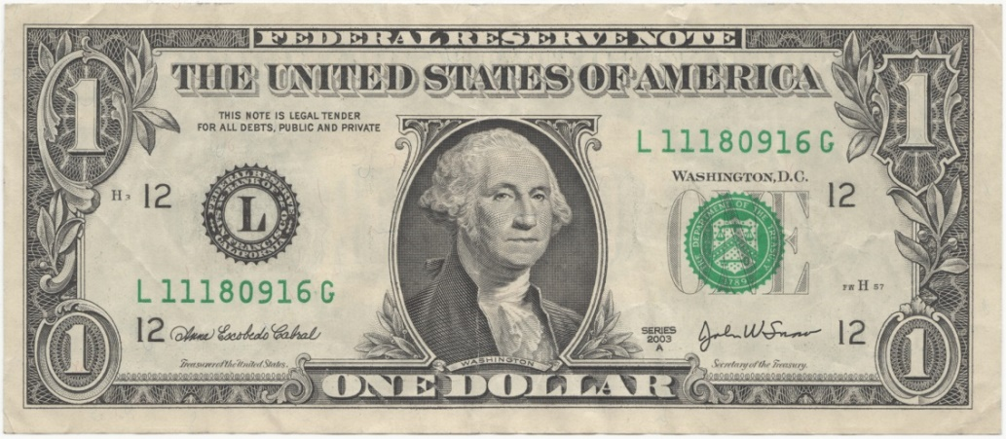
Stay or Leave?
Stay
Stay
Notes:
Our game is a simultaneous variation, where both players need to decide stimulatingly whether to leave or to stay.
The little piggy is the pot. In the onset of the game there is small amount of money in the pot, let say one pound.
Why this game?
Binary decision – simple
Cognitive meaning
An agent can use the prediction to play with another human player
You don't want to end up staying when the other guy is leaving

Slide 79
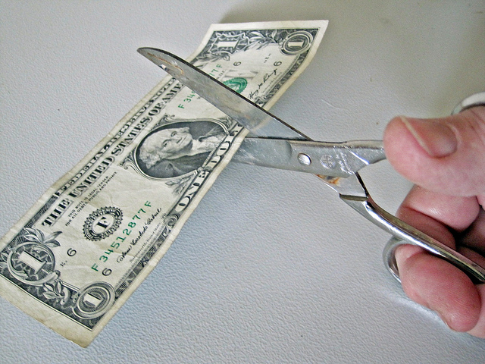

Stay or Leave?
Leave
Leave

Slide 80
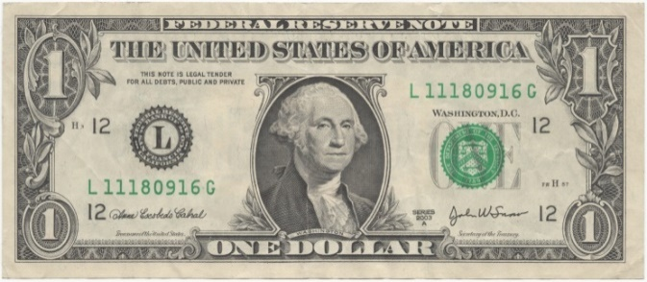
Stay or Leave?
Leave
Stay

Slide 81
After each round the money is being duplicated
Notes:
The normal form of the game
I want to show you that even in our version of the game the solution is to leave immediately.
I’ll show it using backward induction

Slide 82

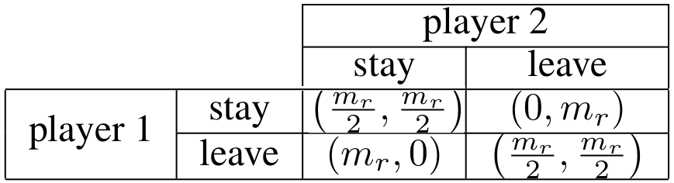
Notes:
The last round is a special case, if both players choose to stay, the split the money like in the leave-leave case.
So to leave is the dominant strategy

Slide 83

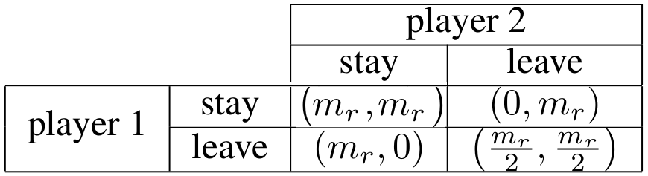
Notes:
Both players will leave on the last round, so one round before the last, the payment for stay-stay will (mr, mr), half of the money in the next round. So again, leave is the dominant strategy.

Slide 84

Leave or Stay?
Notes:
We know that people are not playing such games according to the equilibrium. So how can we know if they are going to stay or leave?
I’ll show you a video of one round of one subject thinking what to do until she made her decision.
First we wanted to see if how well can humans predict the decsions based on facial expression

Slide 85

Notes:
Here suppose to be the movie clip.
So what do you think the subject has decided?

Slide 86
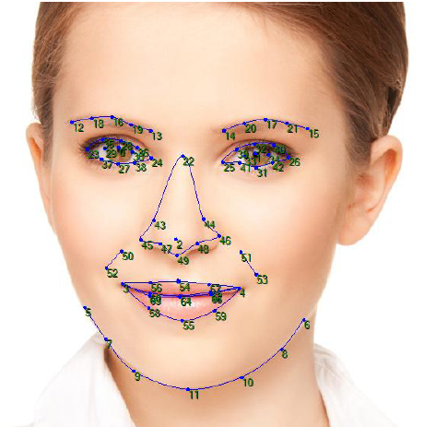
Notes:
To identify facial expression we used a software that tracks 66 facial points

Slide 87
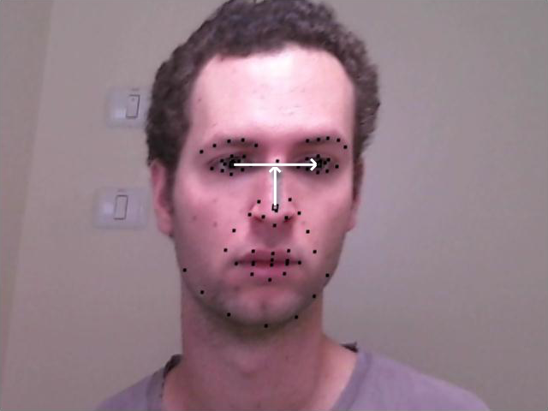
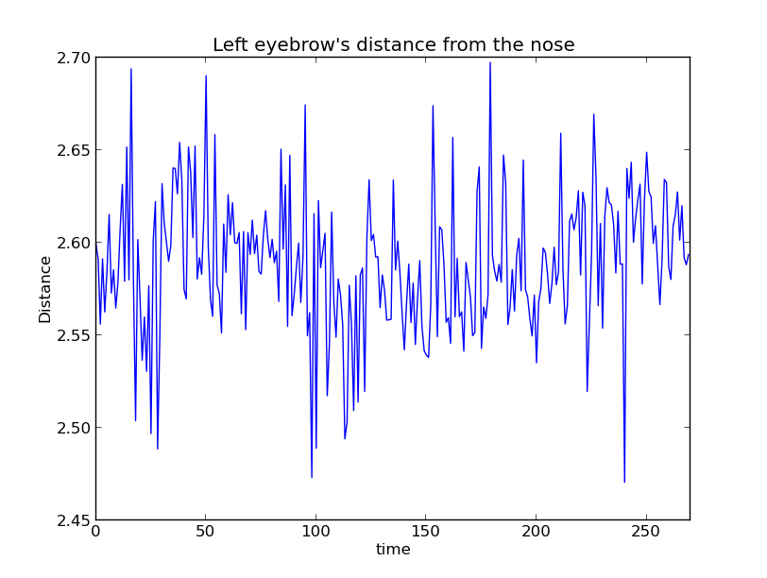
Notes:
Here is the frame after normalization.
We represent each dot in polar coordinates, so for the whole round for each dot we have 2 time series – its distance from the nose and the angle.
You can see as an example the time series represents the distance from the most left point in the eye brow to the center of the nose.

Slide 88

66 Facial Points – polar coordinates (x2)
(X,Y) Nose center position
Face Angle
Nose to eyes ratio
Total 136 x T

Slide 89
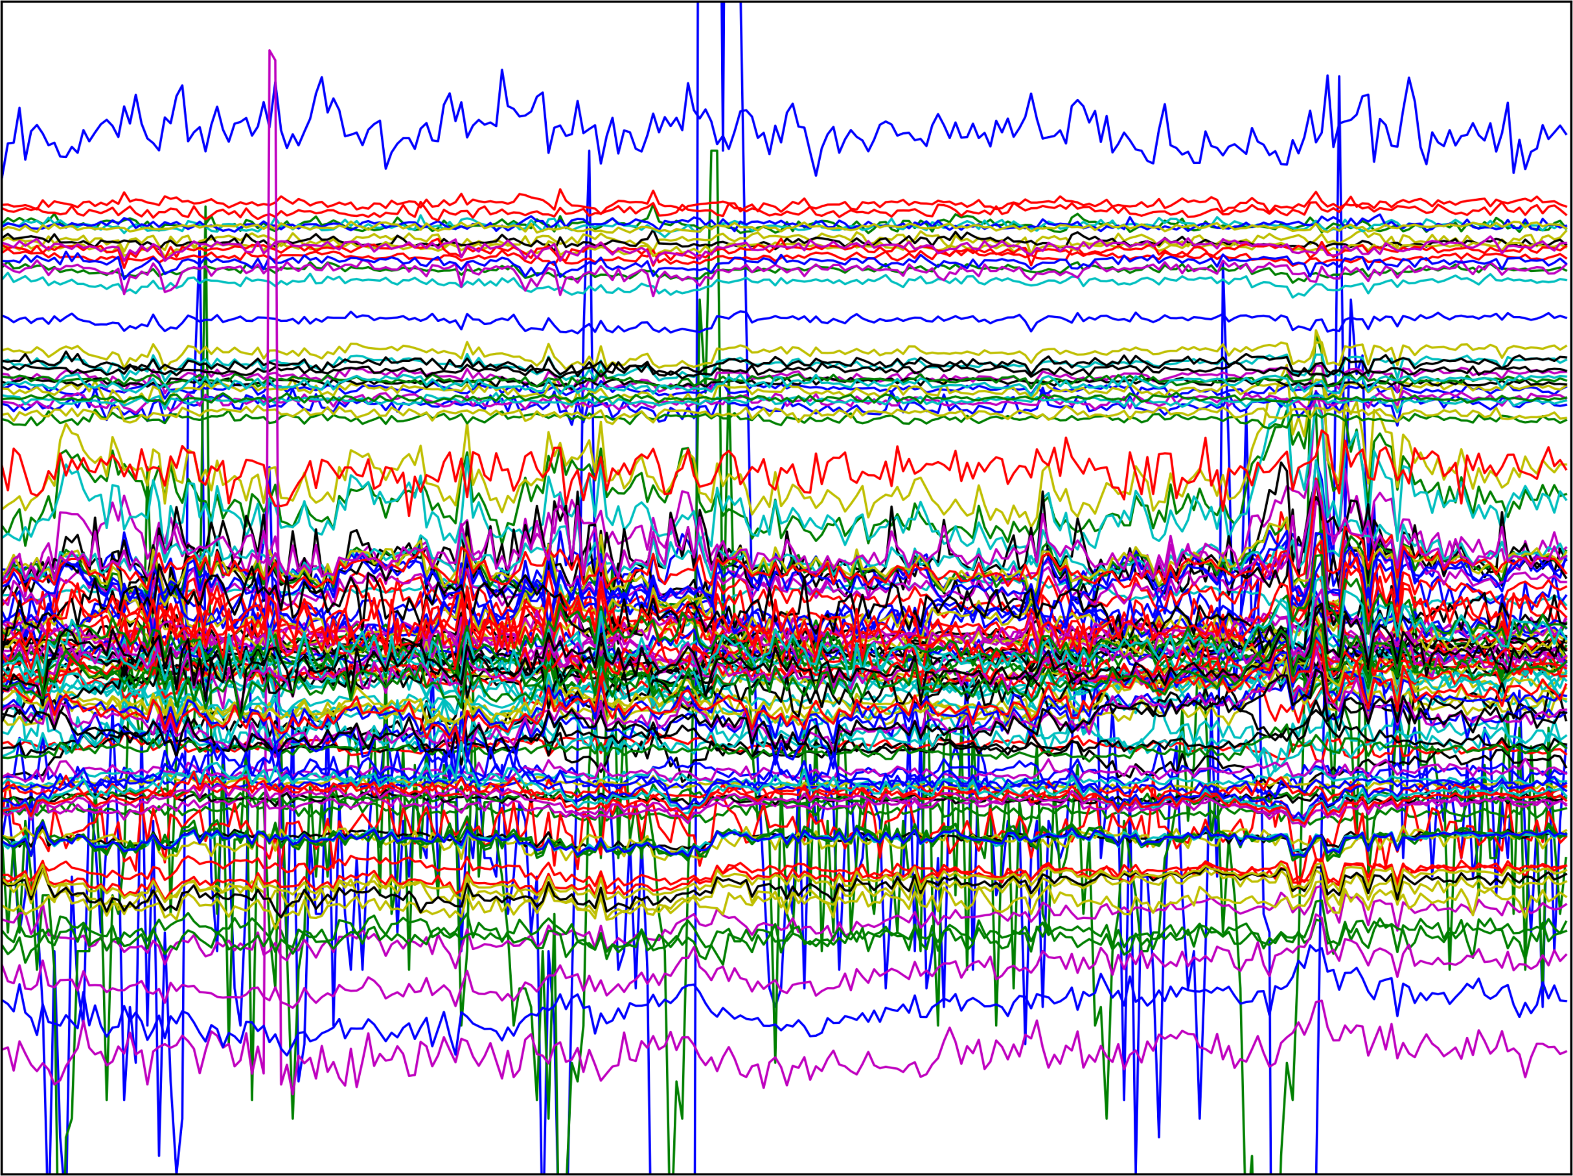
Notes:
Here you can see all the time series for a given round. You can see it’s a mess

Slide 90
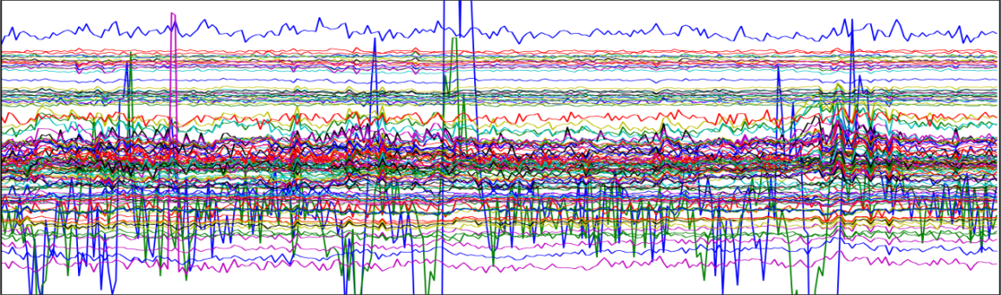

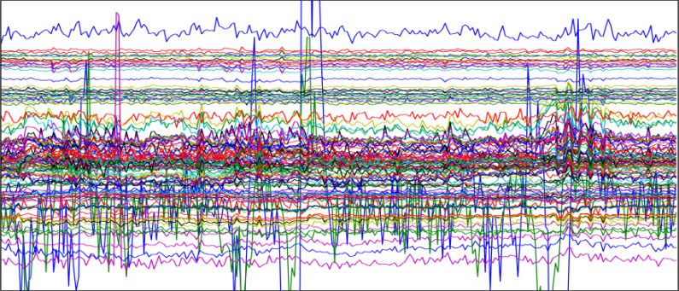

Notes:
And we have a problem that each round is in different length!

Slide 91

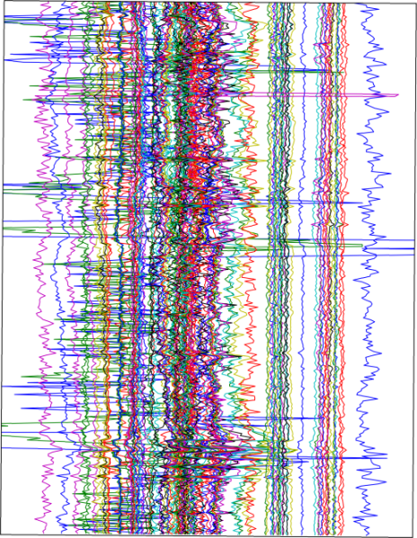

x
=
To extract a features vector with a
constant length for all rounds,
we calculated the covariance matrix
of all the time series for each round
the information lies in the correlation
between the moving points,
not each point separately
Notes:
So to extract a features vector with a constant length for all rounds, we calculated the covariance matrix of all the time series for each round
Now, the information lies in the correlation between the moving points, not each point separately

Slide 92


Notes:
Another problem is the imbalance of the data.
For each ~8 stays, we have 1 leave

Slide 93

Notes:
Here is the ROC curve of a SVM classifier, trained using cross-validation over the subjects:
Train: Other subjects, except the current subject and its opponent
Test: The current subject
You can see that it’s a crappy classifier – it always predicts “stay”

Slide 94

Notes:
We used a double loss SVM, where there is a different C for each class.

Slide 95

Notes:
It’s proven that balancing the data set maximizes the AUC (area under the curve)
There are 2 different balancing approaches:
1) Re-sampling of the minority records
2) Under-sampling of the majority records
Here we used the re-sampling

Slide 96

Notes:
With the cross-validation over the subjects, we didn’t use the current subject’s history for training.
So we used the leave-one-out method
Train: Other subjects + player's history + opponent history
Test: current record
It didn’t really help here

Slide 97

Notes:
We tried the other balancing method – the under-sampling

Slide 98

Notes:
Instead of duplicate the minor class records, we used the SMOTE algorithm to produce new synthetic data sets.

Slide 99

Notes:
We hypothesized that the prediction accuracy can improved for records with longer history.
Here in the graph you can see there is a significant improvement until history length of 70.
So for records with history length of at least 70 rounds, we reach accuracy rate of 70% for both classes, which is quite astonishing!

Slide 100

Notes:
So we took now only the records with history length of at least 70 rounds. You can see the great improvement in the AUC

Slide 101
Machine Learning for Homeland Security
Extremely useful.
Difficulty: collecting data.
Difficult to identify features.

